Slide 1

Concept to Deployment: SOME Acoustic and Friction Optimization Initiatives At The MNROAD TEST FACILITY
Bernard Igbafen Izevbekhai, P.E.
Transportation Research Board Annual Conference. (Session 773)
January 2012

Slide 2
SEQUENCE
Friction and Acoustic Improvement/ Optimization in Texture Direction
  Longitudinal Drag
  Transverse Drag
Improvement of Diamond Grinding Configuration for Acoustic and Friction Optimization
  Conventional Grind→2007 Innovative Grind→2008 Innovative Grind with Corrugation→ 2010 Ultimate Grind

Slide 3
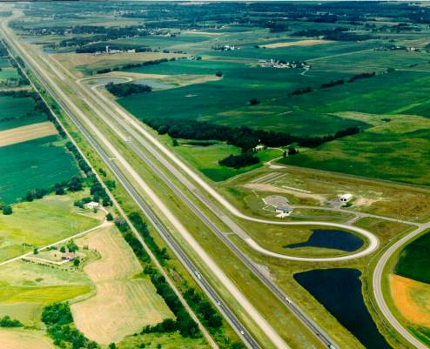
Low Volume Road
Interstate 94
Mainline

Slide 4
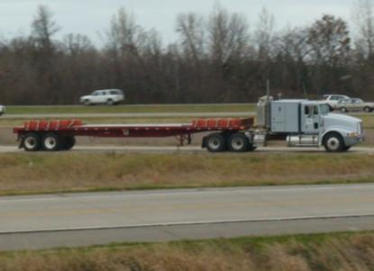
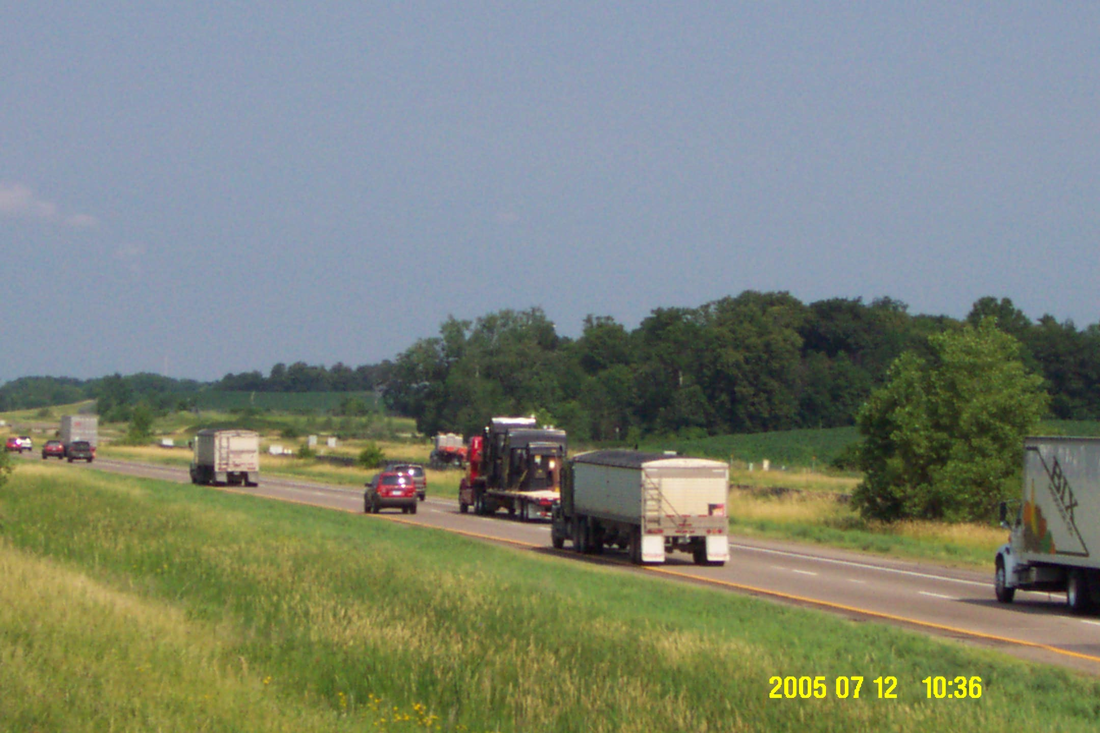
MnROAD Traffic Loadings
Low Volume Road Traffic
MnROAD 5-axle Semi
Inside Lane = 80k truck 5 days/week
Outside Lane = 102k truck (pre-2007);
no traffic since then
Mainline Traffic
I-94 WB Public Traffic
28,200 AADT
12.1% Trucks

Slide 5
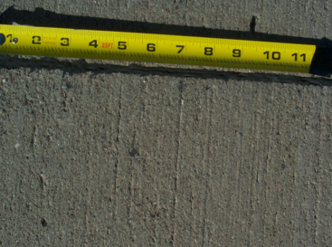
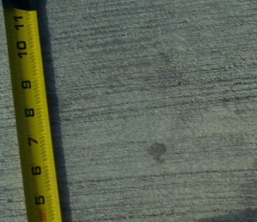
Drag Texture Direction Initiatives
2008
Longitudinal Broom Drag and Turf Drag Cells 13 and 14
Transverse Broom Drag Cell 53 MnROAD
2011
Cell 5 (East End) Transverse Drag

Slide 6
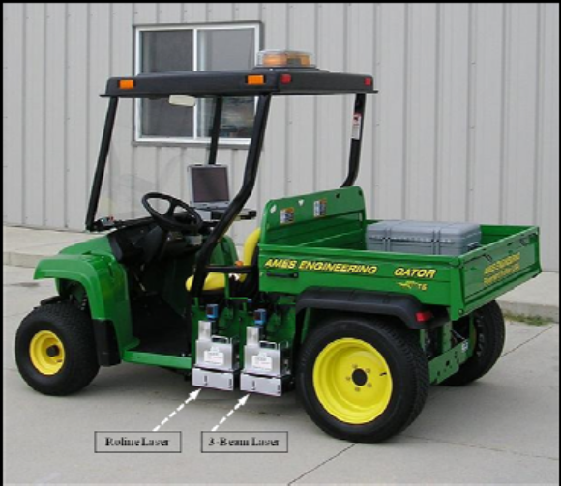

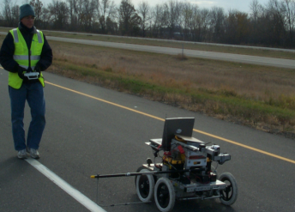
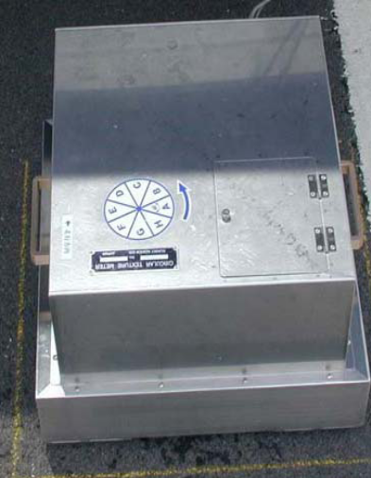
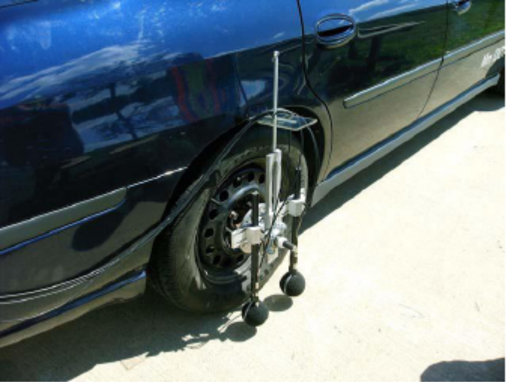
Parallel Testing
Friction ASTM E-247
International Roughness Index
ASTM E-950
Profile Depth
ASTM E-2157
On Board Sound Intensity AASHTP TP 76-11
ROBOTEX

Slide 7
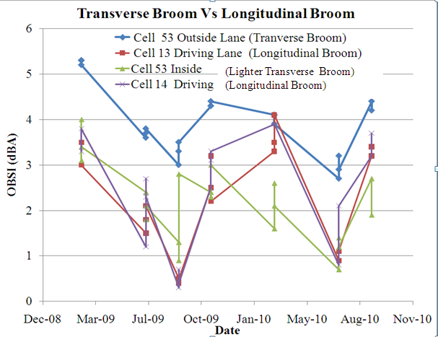
TEXTURE DIRECTION

Slide 8
TRANSVERSE VS. LONGITUDINAL DRAG
Pop outs in cell 14 may have influenced increased OBSI

Slide 9
TRANSVERSE VS LONGITUDINAL TURF, UDG VS LONGITUDINAL TINE

Slide 10
TRANSVERSE VS LONGITUDINAL TURF

Slide 11
TRANSVERSE VS LONGITUDINAL TURF,

Slide 12
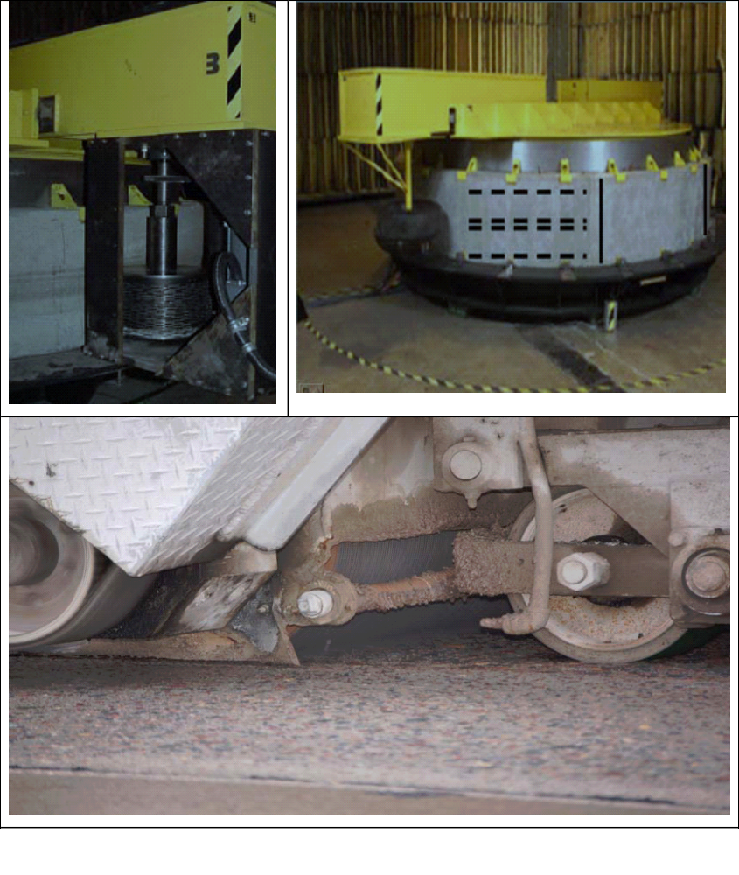
DIAMOND GRINDING PROGRESSION
LAB CONCEPTUALIZATION
Purdue Lab Wheel
MNROAD FIELD DEMONSTRATION
Conventional Grind
Innovative Grind
Ultimate grind
2010 Ultimate Grind

Slide 13
Summer 2007 MnROAD Proof of Concept Grind and Evaluation
TS1 was a flush grind and groove in one pass, TS2 was the flush grind and groove in 2 passes,
TS3 was the conventional grind of .125X .125 X 0.066 inch grove land, depth configuration TS1 and
TS2 represented the innovative configuration with the difference of the number of passes to achieve each configuration.
TS4 was the original non-uniform transverse tine that was in the entire lane before grinding.

Slide 14
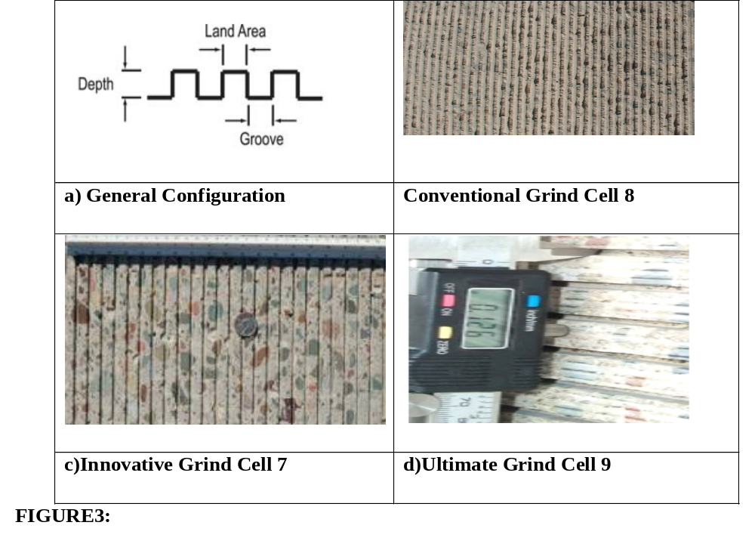
2007 FULL SCALE INITIATIVE MNROAD MAINLINE

Slide 15
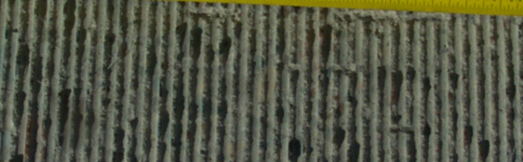
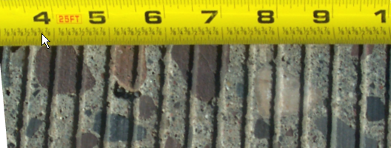
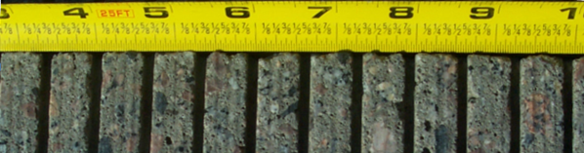
DIAMOND GRIND IMPROVEMENTS
2007 TRADITIONAL GRIND
2007 INNOVATIVE GRIND
2008 INNOVATIVE GRIND

Slide 16
2007 FULL SCALE INITIATIVE MNROAD MAINLINE
 | Cell 37 Multiple Strips 2007 |  | Cell 7 Innovative 2007 |  | Cell 8 Conventional 2007
 | Inch | Mm | Inch | mm | Inch | mm
Mean Land Width | 0.375 | 9.5 | 0.375 | 9.50 | 0.125 | 3.175
Mean Groove Depth | 0.1 | 2.54 | 0.120 | 3.048 | 0.125 | 3.175
Mean Groove Width | 0.125 | 3.175 | 0.125 | 3.125 | 0.125 | 3.175
Mean Texture E-965 | 0.047 | 1.2 | 0.035 | 0.9 | 0.047 | 1.2
Mean Profile Depth ASTM E-2157 | 0.047 | 1.2 | 0.035 | 0.88 | 0.047 | 1.2
OBSI (AASHTO TP 76-08) | 99.0 |  | 99 |  | 102.7
Ribbed Tire Friction ASTM E-274 | Not Feasible |  | 52 |  | 68
Smooth Tire Friction ASTME-274 | Not Feasible |  | 45 |  | 55
Corrugated Landing | - |  | - |  | -

Slide 19
EVALUATION OF 2008 INITIATIVE (ADDED CORRUGATION)
 | Cell 9 2008 Innovation |  | Cell 9 Trans Tining (Before Grinding) |  | Cell 7 2007 Innovation |  | Cell 8 Conv
 | Inch | mm | Inch | mm | Inch | mm | Inch | mm
Mean Land Width | 0.50 | 12.75 | Transverse tine 0.5 to 1inch (12.7-2.4mm) variable interval 1/8 inch (3.108 mm) deep |  | 0.250 | 6.350 | 0.125 | 3.18
Mean Groove depth | 0.31 | 7.85 |  |  | 0.120 | 3.048 | 0.125 | 3.18
Mean Groove Width | 0.12 | 3.28 |  |  | 0.125 | 3.175 | 0.125 | 3.18
Mean Texture E-965 | 0.06 | 1.62 | 0.039 | 1.000 | 0.035 | 0.9 | 0.047 | 1.2
Mean Texture E-2157 | 0.06 | 1.45 | 0.035 | 0.900 | 0.035 | 0.88 | 0.047 | 1.2
OBSI (dBA) | 101.0 |  | 103.0 |  | 98.7 |  | 102.7
Ribbed Friction E-274 | 53 |  | 50 |  | 47 |  | 68
Smooth Tire Friction | 50 |  | 30 |  | 49 |  | 48
Notes:
EVALUATION OF 2008 INITIATIVE

Slide 20
PREDEPLOYMENT ON MILE POST 175 INTERSTATE 94 NEAR ST. CLOUD
In 2009, > 10 mile rehabilitation project, innov diamond grinding
on 1000-ft of a 4-lane divided highway
originally textured with burlap drag in 1980. Over the years, with a traffic volume of 14000AADTand a ADTT of 1700,
Condition of the joints in the 27-ft dowelled skew jointed panels
ranged from good to poor. Joints fair to poor repaired before
grinding.
Some extensively damaged panels were ether partial depth repaired
or full depth repaired.
Configuration of Cell 7 + corrugation of Cell 9 to improve friction
and acoustics
A Phenomenological acoustic prediction model validation.

Slide 21
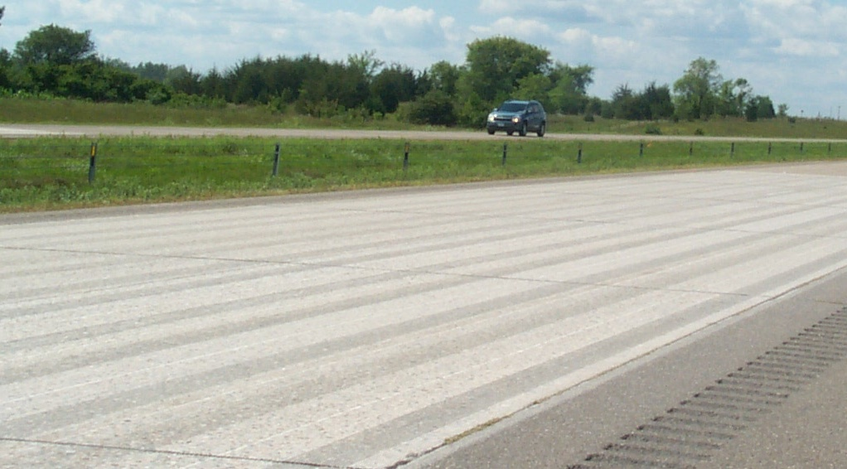
PREDEPLOYMENT TH 94 NEAR St CLOUD

Slide 22
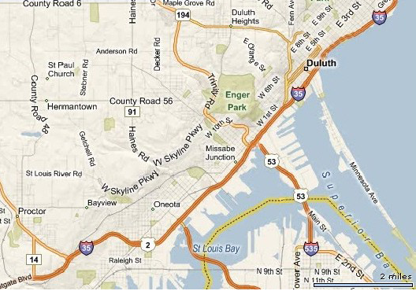
FULL DEPLOYMENT ON TH 35 DULUTH

Slide 23
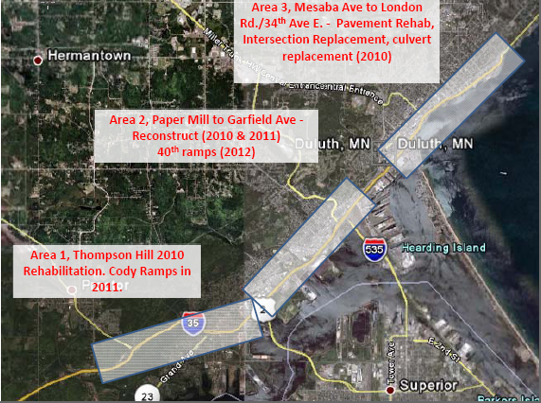
FULL DEPLOYMENT ON TH 35 DULUTH

Slide 24
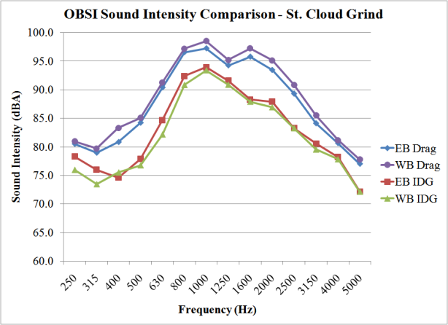
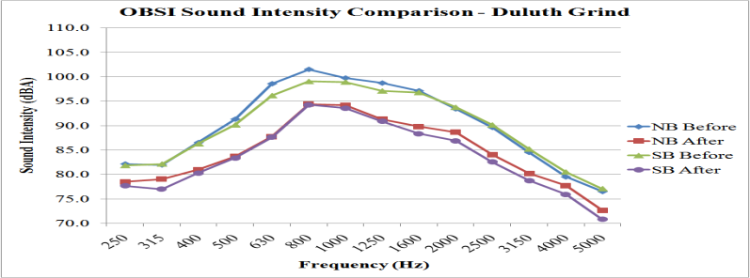
ACOUSTIC IMPROVEMENT:
St. Cloud & Duluth Project Texture Designs
Acoustic improvement occurred in all 3rd Octave Frequencies

Slide 25
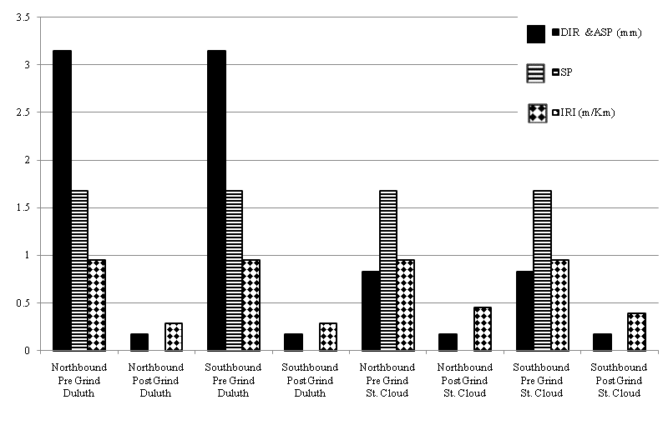
MODEL APPLICATION
Contribution of Component Variables to Noise Reduction in 2 Projects

Slide 26
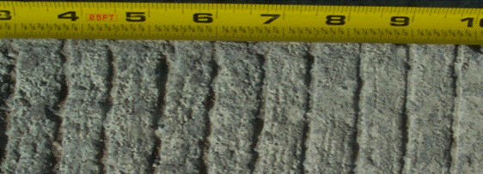

LONGITUDINAL TINE VS ULTIMATE GRIND
2011 LONGITUDINAL TINE
2011 LONGITUDINAL TINE
2010 ULTIMATE GRIND
Comparable Friction Much More Noisy

Slide 27
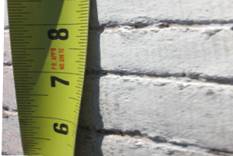
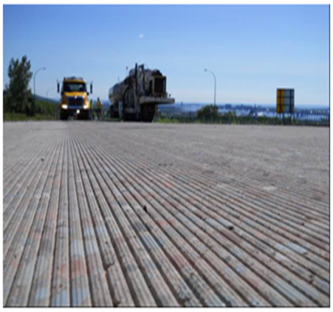
BEFORE & AFTER
Original Transverse Tine
TH 35 Duluth
2010 Ultimate Grind
TH 35 Duluth Cell 37 TS5 MnROAD
Cell 71 MnROAD

Slide 28
Application OF THE PHENOMENOLOGICAL MODEL:
St. Cloud and Duluth Project Texture Designs
OBSI=99.023+20.164((293-T)/T)+[(ASPT/ASP)(1.513 DIR+0.098)]+5.849(IRI/IRIT)+1.684 SP
Izevbekhai, Khazanovich and Voller (2011)
 | DULUTH |  | ST. CLOUD
PREGRIND OBSI | Northbound | Southbound | Northbound | Southbound
ASP (mm) | 13 | 13 | 3 | 3
DIR | 1 | 1 | 0 | 0
SP | 1 | 1 | 1 | 1
IRI (m/Km) | 2.5 | 2.5 | 2.5 | 2.5
Temp( ⁰K) | 288 | 288 | 295 | 295
Predicted Pre Grind OBSI | 105.1 | 105.1 | 102.4 | 102.3
Measured Pre Grind OBSI | 106.1 | 105.2 | 103.2 | 103.2
POST GRIND OBSI
ASP (mm) | 15 | 15 | 15 | 15
DIR | 0 | 0 | 0 | 0
SP | 0 | 0 | 0 | 0
IRI (m/Km) | 0.75 | 0.75 | 1.2 | 1.05
Temp( ⁰K) | 290 | 290 | 298 | 298
Predicted Post Grind OBSI | 99.68 | 99.68 | 99.3 | 99.3
Measured Post Grind OBSI | 99.7 | 99.3 | 98.7 | 98.2

Slide 29
INVESTIGATING ALTERNATIVE TO GRINDING

Slide 30
INVESTIGATING UDG VS LONGITUDINAL TINE

Slide 31
ULTIMATE DIAMOND GRIND VS LONGITUDINAL TINE

Slide 32
UDG VS LONGITUDINAL TINE

Slide 33
Simple Texture Decision Number Proposed
DN = (FN_{R}-40) I₁+ (FNs-20) I₂ -(OBSI*-100) I₃ - (RR_{SRTT50}-0.013)I₄- (SS-Ԑ)I₅
- (0.01 LMC)I₆
Where DN is a decision number, (the higher the better)
FN_{R ,} FNs are respectively Ribbed tire friction and smooth tire friction after 1 year . OBSI* is characteristic OBSI normalized to 1 m/km and 293 Deg. K
RR_{SRTT50} is rolling resistance of SRTT measured at 70km/hr
SS is a splash and spray index and Ԑ is a convenient SS pivot.
LMC is the NPV of texture investment over a 10 year period
I₁ to I ₆ are respective institutional constants
(This Lemma does not institute or imply a standard for acceptable friction number)

Slide 34
CONCLUSION
Transverse Drag does not seem to produce significant acoustic difference from Longitudinal Drag. The benefits derivable from friction optimize both variables in Transverse Drag.
Replication of Innovative diamond grind benefits with longitudinal tining still seems remote
Each stage of the diamond grinding development process demonstrated improvement in acoustic properties steadily from concept to deployment.

Slide 35
CONCLUSION
The 2010 Ultimate grind is by far the quietest and most recent of the diamond grinding initiatives.
A Phenomenological acoustic model by Izevbekhai Khazanovich and Voller was validated in the Pre-deployment (St Cloud) and full scale deployment (Duluth) of the 2010 Ultimate Grind.
This model includes texture direction, orientation, temp, IRI and asperity interval functions. The ultimate grind maximizes the quest pavement variables and provides sufficient friction.
A decision number for texture selection is proposed.

Slide 36
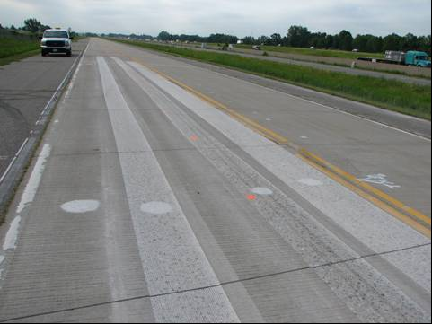

QUESTIONS
I THANK THEE

