Slide 1







INTERCONTINENTAL COLLABORATION
IN ROLLING RESISTANCE MEASUREMENT
Bernard Igbafen Izevbekhai
Jerzy (Jurek) A. Ejsmont
Technical University of Gdansk Poland
(Politechnika Gdańska)
TRB Session 325 January 23 2012

Slide 2
Acknowledgements
TU Gdansk Poland:
  Principal Investigator: Professor Jerzy Ejsmont TU Gdansk Poland
  Co –Principal Investigator Grzegrz Ronowski
Professor Ulf Sandberg, VTI Sweden
FHWA: Mark Swanlund, Robert Orthmeyer, Larry Wiser
Minnesota State University Mankato: Prof W. James Wilde PI for Diamond Grinding Pooled Fund Study TPF 5-134
Minnesota DOT: Keith Shannon, Maureen Jensen, & Steve Olson
Minnesota DOT: Tim Clyne assisted with some MnROAD Slides

Slide 3
What is Rolling Resistance?
Rolling Resistance is defined as the non-inertial and non-aerodynamic , non- skidding resistance to the interaction of vehicular tire with the road surface
 | Percentage of Total Resistance at
 | Very Low Speeds | 90Km/h | 120Km/h
Inertial Resistance | 41
Air Resistance | 13 | 63 | 75
Rolling Resistance | 46 | 37 | 25
[Silka W.: Energochłonność ruchu samochodu, Warszawa, WKŁ 1997]

Slide 4
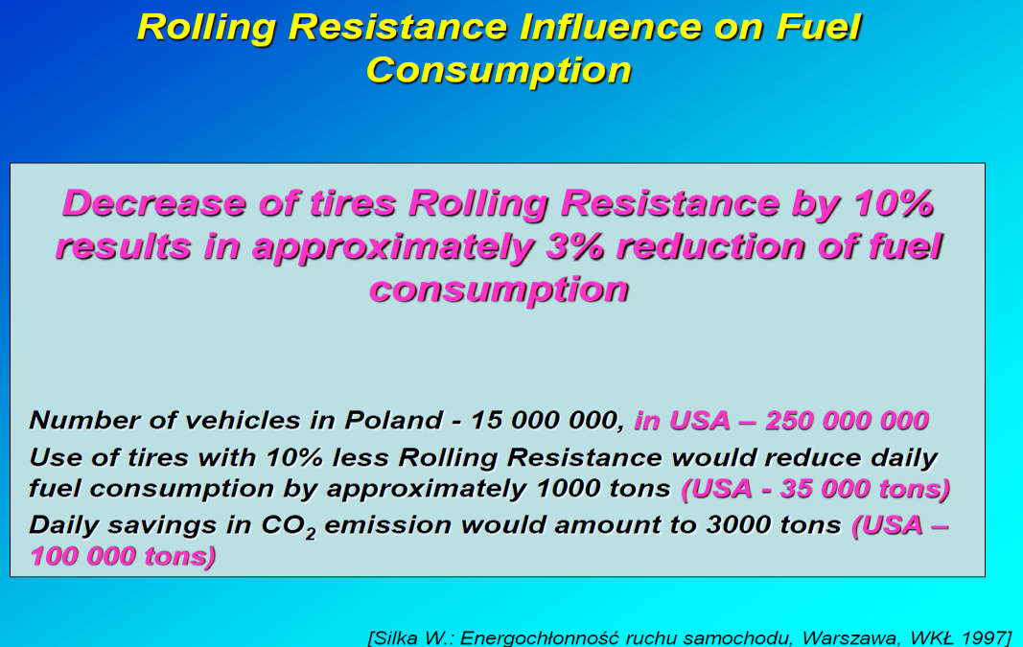
WHY ARE WE CONCERNED?

Slide 5
FUEL CONSUMPTION & RR
At 100 km/hr passenger car expends~50% fuel to overcome RR
At 80km/hr a truck expends ~40% of fuel
to overcome RR
In all driving conditions an overall average ~ 25% of fuel consumption is expended on RR leaving 75% to overcome air drag and inertia.

Slide 6

Beginnings & Conceptualization
January 2010: Ulf Sandberg Presents on Rolling Resistance at TRB AFD 90 Meeting.
Meetings: MNDOT, FHWA, Sandberg on Possibility of testing at MnROAD
November 2010 : Jerzy Ejsmont Visits MnROAD Facility and observes the test cells
April 2011: FHWA adds Funds to TPF 5-134 for Rolling Resistance
June 2011: MnDOT Contract Amended with MSU for Rolling Resistance, MSU Sub-contract with TU Gdansk Executed
August 2011: RR Equipment Shipped to MnROAD Monticello Minnesota USA
September 2011: Testing of All MnROAD Cells
November 2011 Additional Texture (Robotex) tests for better texture Characterization

Slide 7
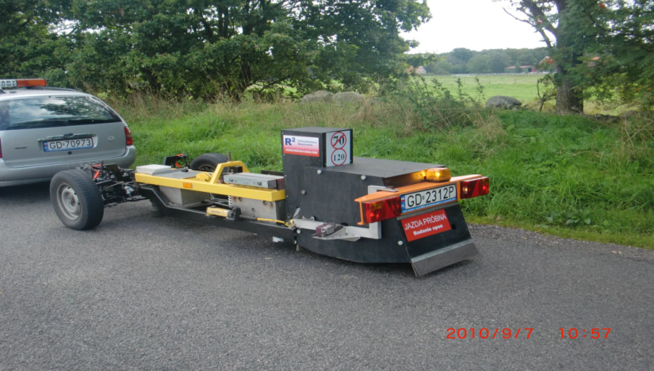
Field Equipment Description
A one-ton articulated device, with a housing for standard tire, (with compensation for pavement smoothness, and other variables) that allows an angular displacement due to resistance between tire and pavement and translates this into a rolling resistance number through mechanics of motion.

Slide 8
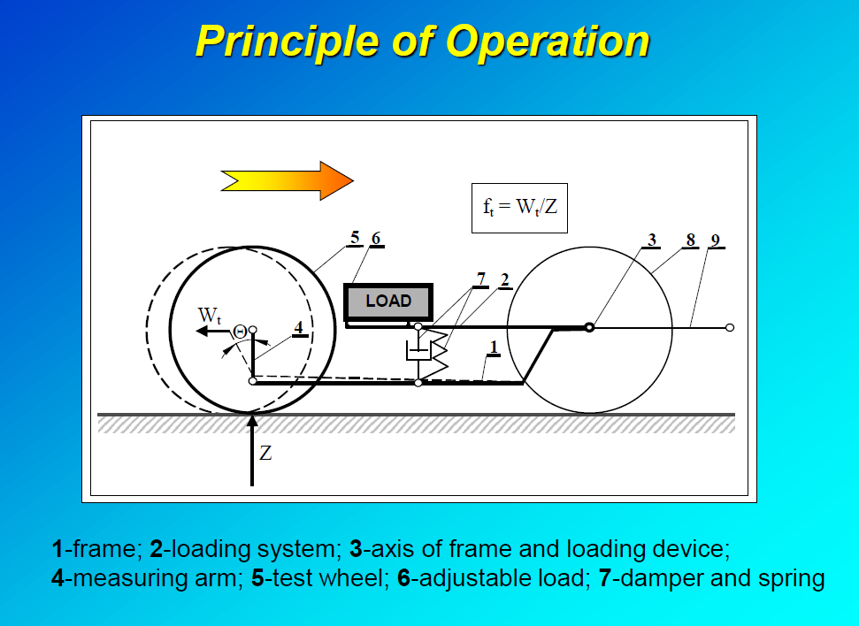

Slide 9
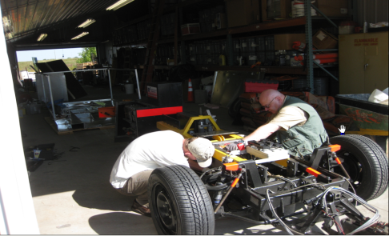
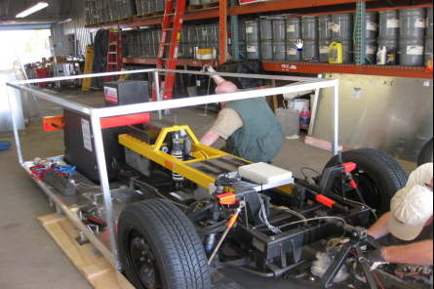
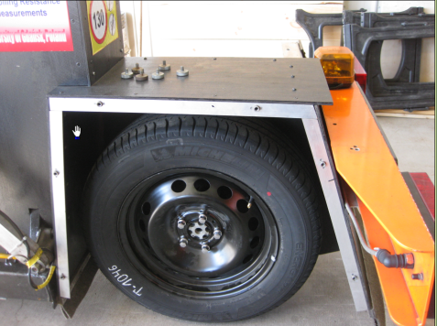
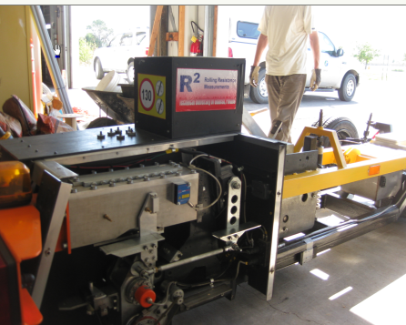
DISMANTLING 1 TON CARGO AND TEST SET UP TON

Slide 10
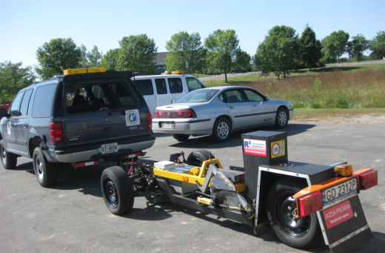
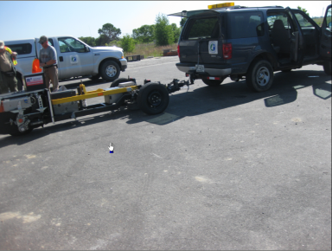
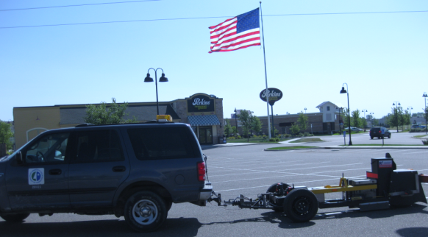
TEST SET UP

Slide 11
RESEARCH MATRIX FORWARD AND REVERSE RUN
 | 50 km/h |  |  | 70 km/h |  |  | 90km/hr
 | AV4 | SRTT | MIPR | AV4 | SRTT | MIPR | AV4 | SRTT | MIPR
MnROAD Mainline Driving Lane (2 Runs each Direction) | x | x | x | x | x | x | x | x | x
MnROAD LVR Inside (Traffic) Lane (2 runs each Direction) | x | x | x | x | x | x | x | x | x
Stone Matrix Asphalt TH 212 in Waconia MN (3 Runs each Direction) | x | x | x | x | x | x | x | x | x
Notes:
MnROAD Cells

Slide 12
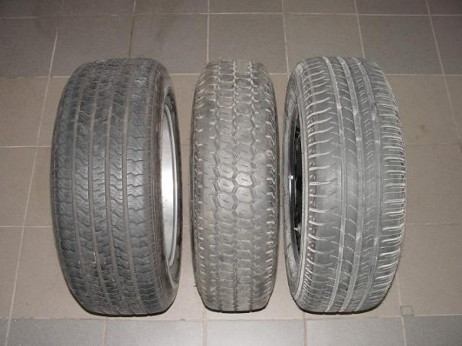
TEST TIRES
Test tires (from the left: SRTT, AV4, MIPR)

Slide 13
WHY MnROAD FACILITY ?
18 Different Surface types in 2 test tracks
Each track is two twelve foot lanes
LVR is a 2.5 mile loop
Mainline is a 3.5 mile Stretch on Interstate 94
Most test cells of unique surface types are 500ft long
Controlled Environment:
Loaded truck on LVR inside lane
Environmental loads on LVR outside lane
Recorded and monitored traffic axle and load input on ML

Slide 14
MnROAD
MnDOT Office of Materials and Road Research
A long-term accelerated pavement testing facility
that gives researchers a unique, real-life
laboratory to study and evaluate the performance
of materials used in roadway construction.

Slide 15
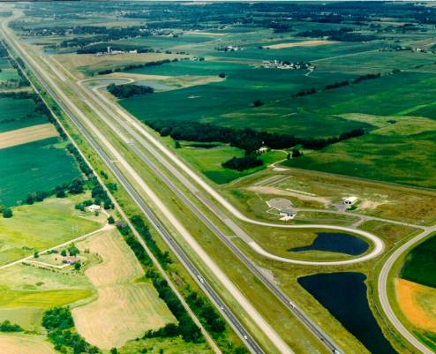
Low Volume Road
Interstate 94
Mainline

Slide 16

MnROAD Operations
10 full time + 4 part time staff
Traffic Loading
  LVR 80K Truck, ML Traffic Switches
Performance Monitoring
  Coordination, Collect & Share Data
Instrumentation & Data Management
  9000+ Sensors
  Oracle Database
Research Support
Facility / Buildings

Slide 17
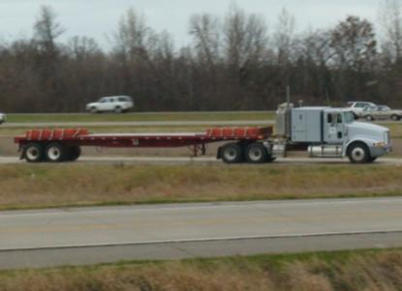
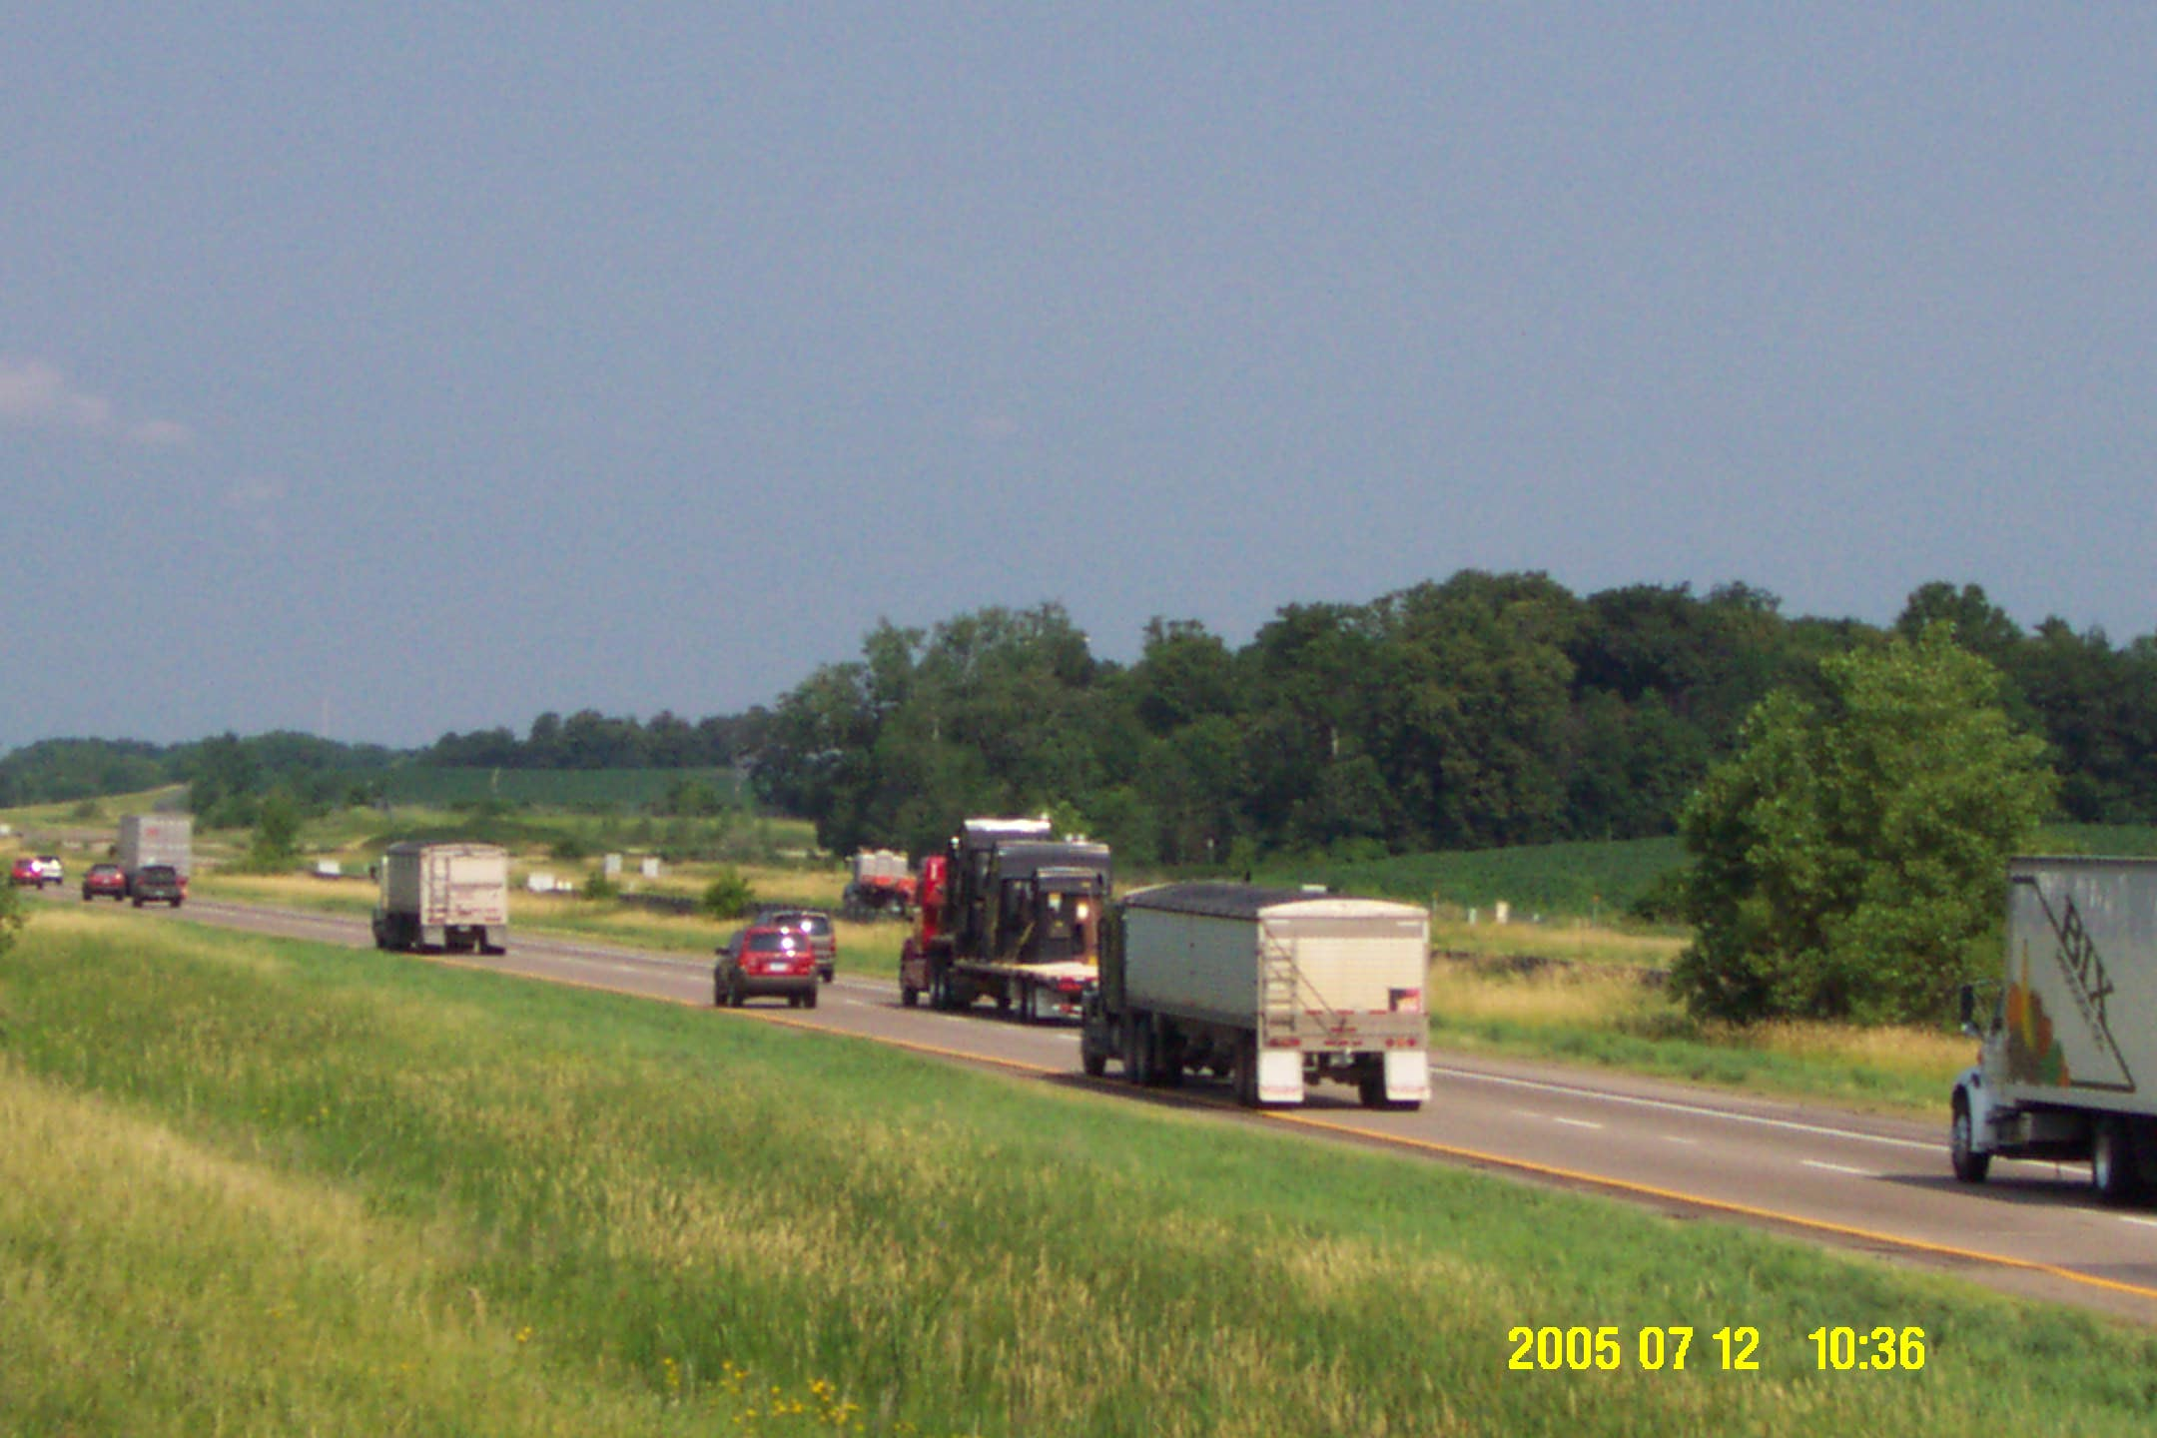
MnROAD Traffic Loadings
Low Volume Road Traffic
MnROAD 5-axle Semi
Inside Lane = 80k truck 5 days/week
Outside Lane = 102k truck (pre-2007);
no traffic since then
Mainline Traffic
I-94 WB Public Traffic
28,200 AADT
12.1% Trucks

Slide 18
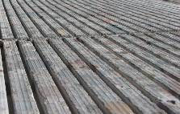



Conventional Diamond Grind
Cells 5, 8, 37 (TS3) and 71 (Passing)
Groove Width – 3.75 mm
Groove Depth – 1.2 mm
Asperity Interval – 6
Ultimate Diamond Grind
Cell 9
Groove Width – 3.75 mm
Groove Depth – 8 mm
Asperity Interval – 15
Innovative Diamond Grind
Cells 7 and 37 (TS1 and 2)
Groove Width – 3.75 mm
Groove Depth – 1.25 mm
Asperity Interval – 12.5
TS1 – 1 Pass
TS2 – 2 Pass
2010 Ultimate Diamond Grind
Cells 37 (TS5) and 71 (Driving). Replicate of I-35 Duluth Grind
Groove Width – 3.75 mm
Groove Depth – 8 mm
Asperity Interval – 15
Transverse Broom Drag
Cell 5, Cell 53
Inside
Groove Width – 2 mm
Groove Depth – 1 mm
Asperity Interval – 2
Outside
Groove Width – 3 mm
Groove Depth – 1.5 mm
Asperity Interval – 2

Slide 19
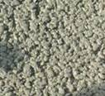
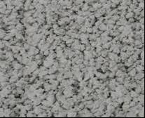
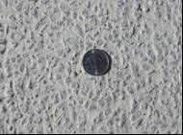

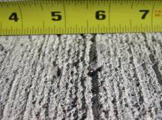
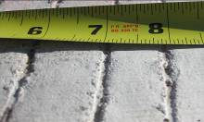
Exposed Aggregate
Cell 72
Groove Width – 4 mm
Groove Depth – 2 mm
Asperity Interval – 8mm
Pervious Concrete
Cell 64, 85 and 89
Used CA-70 with 18 to 21 percent porosity.
Pervious Overlay
Cell 39
Used CA-70 with 18 to 21 percent porosity + Fibers
Longitudinal Broom Drag
Cell 14
Groove Width – 2 mm
Groove Depth – 1 mm
Asperity Interval – 2
Longitudinal Turf Drag
Cells 13, 32, 52, 54, 60, 61,62, 63
Groove Width – 2 mm
Groove Depth – 1 mm
Asperity Interval – 2
Transverse Tine
Cells 12, 36, 37 (TS4 and Inside), 38, 40 and 96
Groove Width – 5 mm
Groove Depth – 1.5 mm
Asperity Interval – 18

Slide 20
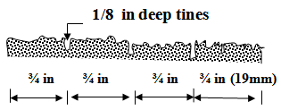
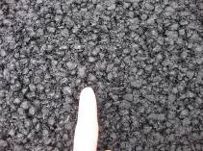
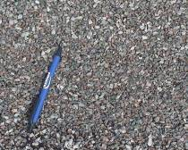
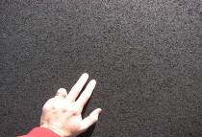
Longitudinal Tine
Cells 7 and 37 (TS1 and 2)
Pre-textured with Astro Turf Drag
Tine at ¾ inch Interval
1/8 inch tine depth
Ultra Thin Bonded Wearing Course
Cells 2 and 3
Gap graded mixture “Nova chip”
9.5 mm NMAS
PG 64-34 (5.1% AC)
4.75 mm Taconite
Cell 6
Fine graded superpave mix
4.75 mm NMAS
PG 64-34 (7.4% AC)
Will be removed Summer 2011
Chip Seals (FA-2 and FA-3)
Cell 27
4.75 or 9.5 mm NMAS
CRS-2P emulsion

Slide 21
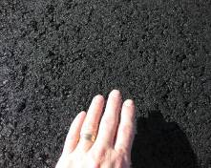
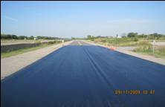

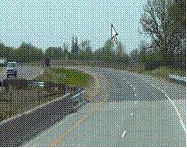

12.5 mm Dense Graded Superpave
Cells 1, 4, 15, 16, 17, 18, 19, 20, 21, 22, 23, 28, 31, 33, 34, 35, 70, 77, 78, 79, 83, 84 and 87
12.5 mm NMAS
0, 20, or 30% RAP
0 or 5% recycled shingles
PG 58-28, 58-34, 64-34 (various binder sources and modifiers)
AC contents 4.8 to 5.7%
12.5 mm Dense Graded Superpave Plus Fog Seals
Cell 24
12.5 mm NMAS
20% RAP
PG 58-34, (5.2% AC)
Porous Hot Mixed Asphalt
Cells 86 and 88
Open graded porous mix
18% air voids
12.5 mm NMAS
PG 70-28 (5.5% AC)
Surfaces Outside of MnROAD:
Stone Matrix Asphalt
TH 212 - RP 147.59 From W end of Bridge Near County Road 10 Westwards to RP 140 approx
12.5 mm aggregate size
Inset 2: Transition from Concrete to SMA, East Limits)

Slide 22
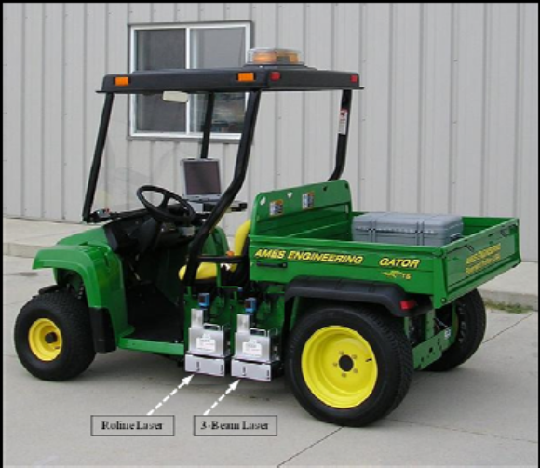

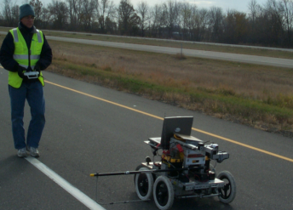
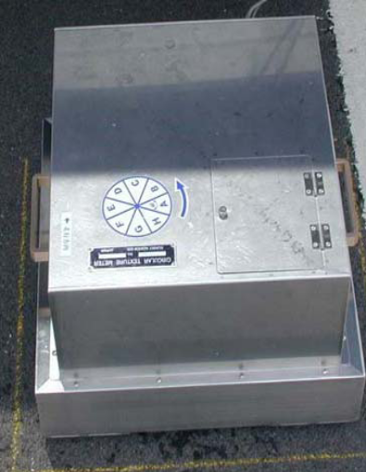
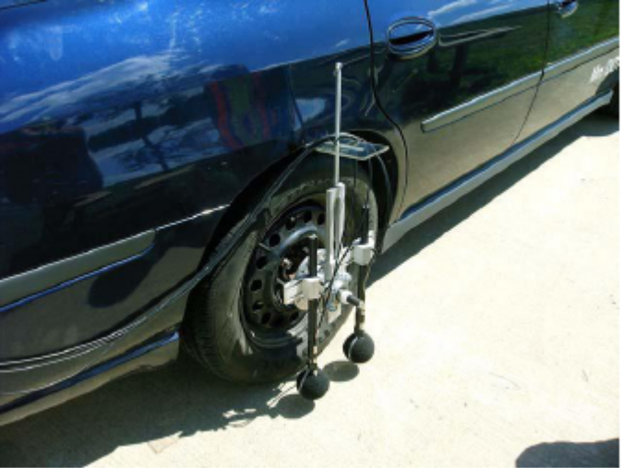
Parallel Testing
Friction ASTM E-247
International Roughness Index
ASTM E-950
Profile Depth
ASTM E-2157
On Board Sound Intensity AASHTO TP 76-11
ROBOTEX

Slide 23
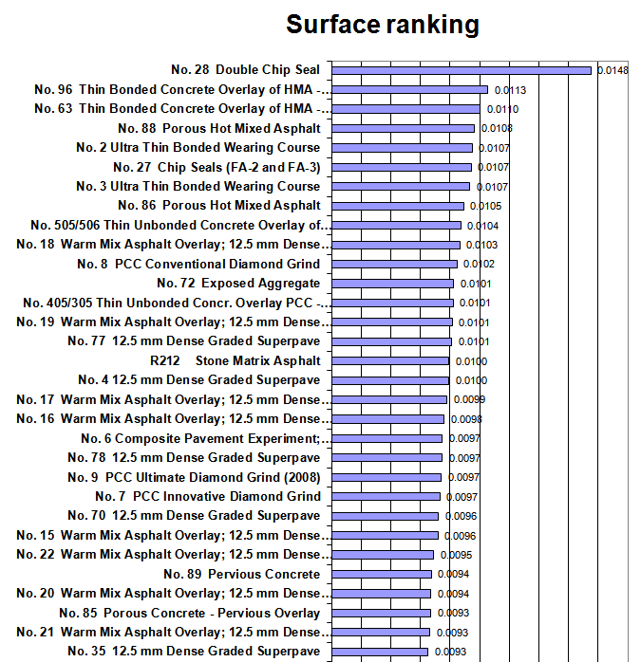
TEST RESULTS UPPER RR

Slide 24
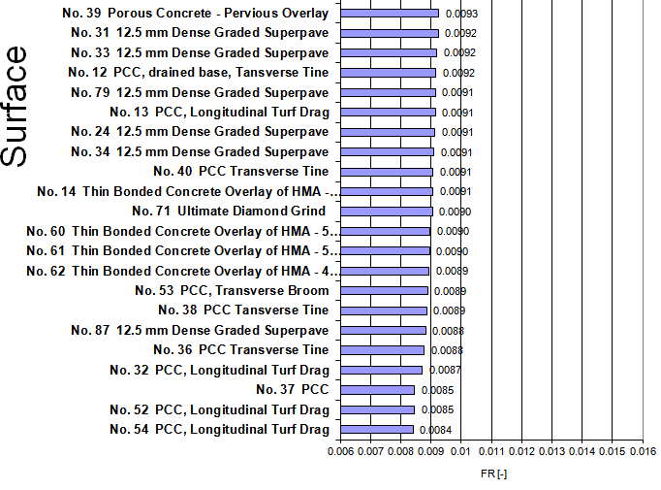
Surface Ranking Lower RR

Slide 26
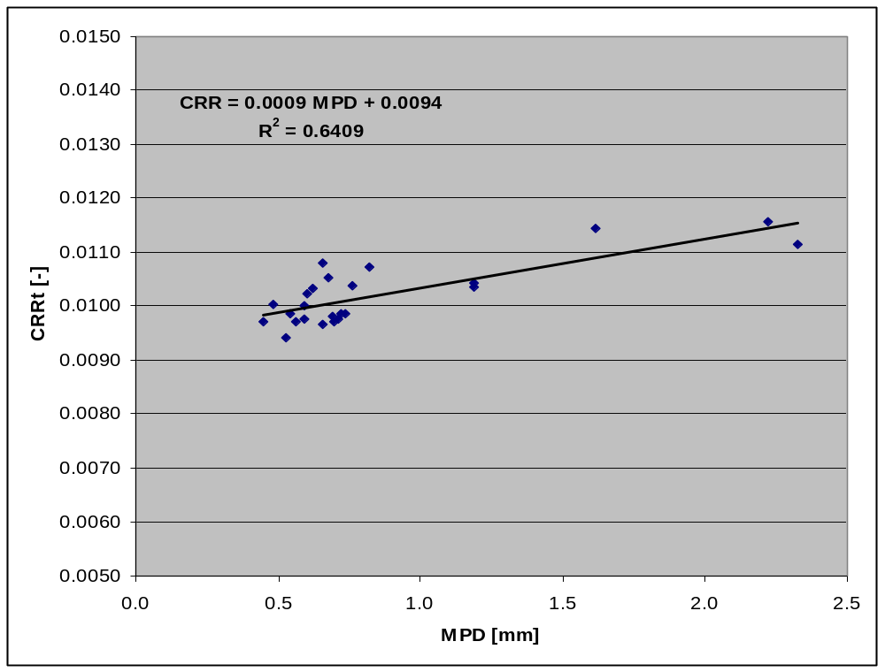
RR CHARACTERISTICS OBSERVED
Relation between MPD (Robotex) and averaged rolling resistance coefficient CRRt for bituminous surfaces, Cell 28 excluded.

Slide 27
FRAGMENTED RR SRTT DETERMINATION COEFFS

Slide 28
DISCUSSION
• There is an order of RR in surface textures. It is conclusive that the drag textures have the least RR. Other textures may be compared but not without mention of some confidence level. Softer, raveled uneven surfaces appear to exhibit high rolling
resistance
Variation of temperature may have distorted the correlation because of possibility of non representative temperature correction procedure based on ISO28580.
•Another variant of MPD, namely when the profile has first been modified by a mathematical function (envelopment) (Hamet 2003) to simulate tire deflection, the calculated MPD on this modified profile is likely more correlated to RR. This may be especially important for the many special textures included in this dataset (grooved concrete).

Slide 29
CONCLUSION
It may also be that the precision and repeatability of the rolling resistance measurements have been different from measurements in Sweden and Denmark, where distances of several hundred meters have generally been used for each test section. MnRoad facility permitted non-disturbed measurements in both directions (3x2 runs for each surface/tire/speed combination) and that should equalize shorter section length.
Fragmenting the data into texture types seemed to produce better coefficients of Determination between RR and Surface Characteristics.

Slide 30
THE WAY FORWARD
It is possible that each texture type has a unique RR variability function. Identification of individual RR function for various texture types may enhance better prediction model.
CONTINUING RESEARCH IS NEEDED!!!
Periodic 2-year interval of measurements of the MnROAD Cells is recommended. Other test tracks: SMART Road, NCAT may be measured also to facilitate a robust database.
Results of MnROAD RR testing is being reviewed and will be published in March 2012. (Look out for it)

Slide 31
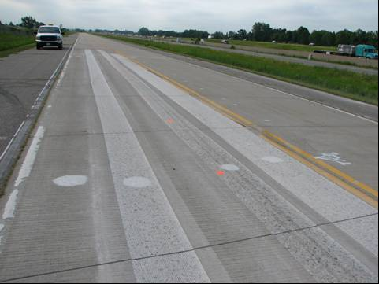

QUESTIONS
I THANK THEE

