Slide 1

Closing Comments

Slide 2
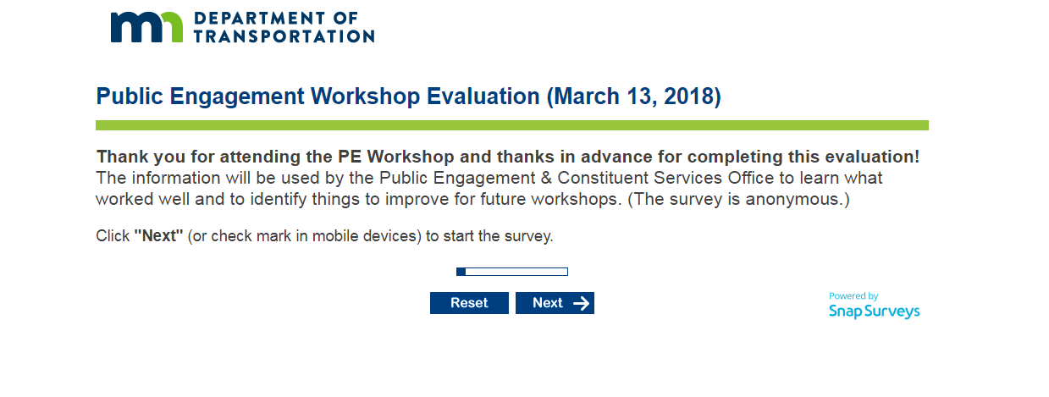
Next Steps – Workshop Evaluation
http://survey.mn.gov/s.asp?k=152054504414

Slide 3

Video

Slide 4
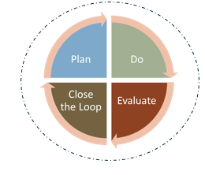
360° of Public Engagement

Slide 5
Thank You
U of MN Staff
PECS Team
Norm Plasch
Speakers and Presenters
Attendees

Slide 6
See you next year!

