Slide 1

Public Engagement Workshop
PECS
3/13/2018

Slide 2
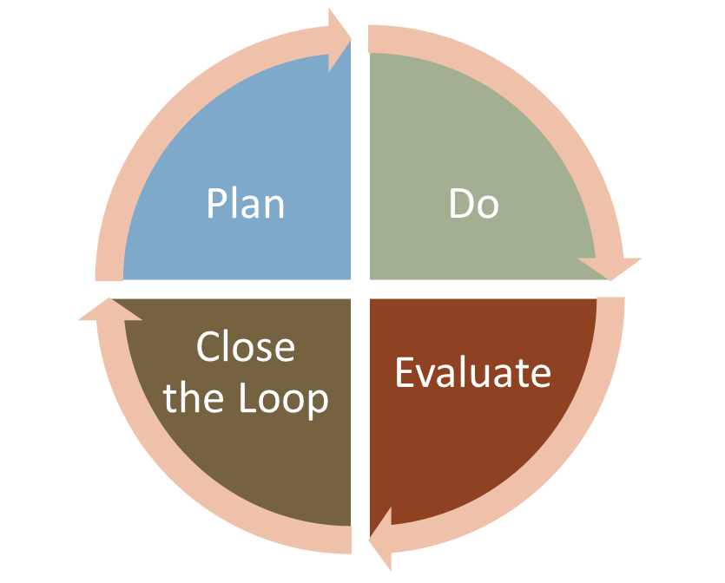
Evaluation
PECS - Market Research / Jan Kihm (Renee Raduenz)

Slide 3
MnDOT’s Evaluation Goal
Systematic Framework
(deliberate)
Customizable
(relevant & feasible)
Valuable
(insightful & actionable)
A process of systematic inquiry to provide sound information about a program for a valued purpose
Simplified definition from “Interactive Evaluation Practice (Mastering the interpersonal Dynamics of Program Evaluation)” by Jean A. King / Laurie Stevahn (2013)

Slide 4

Enterprise Initiative
Nick Kor - Civic Engagement Director for the State of Minnesota
Bush Foundation Initiative
  Looking at evaluation practices across entities
  MnDOT will be involved in contributing to and learning from this endeavor
Notes:
Nick Kor is the Civic Engagement Director at the Minnesota Department of Human Rights. In his role, he works to implement the state’s Civic Engagement Plan as a part of the Governor’s Diversity and Inclusion Council

Slide 5
Background
In a civic engagement survey administered in 2015, more than 20 of 24 cabinet agencies asked for help with measuring their civic engagement work.
Civic Engagement plan states, “agencies should measure qualitative and quantitative indicators when performing meaningful engagement.”
GOAL: agencies have the tools and best practices to evaluate their civic engagement efforts

Slide 6
Project Overview
MDHR has contracted with The Improve Group to:
Research existing civic engagement evaluation measurements and metrics used by a sample of executive branch agencies, other government entities, nonprofits, and businesses, around the state, country or even internationally.
Based on the research, develop a menu of evaluation measures and metrics that agencies can use. Create written guides to assist in their use.
Work with 2-3 efforts from agencies to pilot these research measures.
Develop case write ups of these efforts so that those inside and outside the State of Minnesota can learn about the initiatives.

Slide 7
Agency Pilot Projects
Environmental Quality Board (EQB) Public Meetings - The EQB is exploring new and innovative ways to make their monthly board meetings more engaging for communities. This project will pilot the tools to measure engagement at public meetings.
MnDOT Rethinking I-94 - MnDOT is working with partners on a two-year project to develop a vision for the Interstate 94 corridor between St. Paul and Minneapolis. This project will pilot tools for measuring engagement on large infrastructure projects.
Olmstead Implementation Office (OIO) Community Engagement Outcomes – OIO seeks to build and train state agencies on a “Community Engagement Outcome Evaluation Toolkit” as they continue to build their capacity for engaging disability communities. This project will pilot tools for measuring engagement on large interagency service delivery initiatives.

Slide 8
Final Thoughts
How to evaluate civic engagement is a big need in state government and is critical to doing our work effectively
Many people and agencies are doing and trying different things
MDHR will continue to collaborate with MNDOT in developing and sharing evaluation tools for engagement.
Reach out to me if you want opportunities to share your work and to be more connected at the larger enterprise level.
  Nick Kor
  Civic Engagement Director
  651-539-1088
  Nicholas.kor@state.mn.us

Slide 9
Plug evaluation Into planning
Before
(Pre)
Characteristics of audiences/segments (traditions, attitudes, values, behaviors, etc.)
During
Evaluation of specific efforts right after they happen
After
(Post)
Evaluation of all the communication/public engagement efforts
Assessment of overall goals (for the work, completed project, livability, MnDOT, etc.)
Conceptual preferences (designs/solutions, content, methods of engagement, etc.)
Awareness of information/engagement opportunities
Specific preferences (design elements, communication and engagement methods, etc.)
Changing needs, as plans and projects progress

Slide 10
Quick Examples to Highlight
Insightful first steps
“BEFORE” Example: Social media pilot study
  A follow-up effort to get more actionable detail
  Show different ways to use this data
“AFTER” (Post) Example: Highway 53 post-project pilot evaluation
  Research design considerations
  What we learned about PE and evaluation
  How project teams can contribute to and use evaluation insights

