Slide 1

2018 MnDOT Public Engagement Workshop
Richard Davis
Director - Public Engagement & Constituent Services

Slide 2
Welcome
Registration Packet Materials
Housekeeping Items and Rules for the Day
PECS Team
  Renee Raduenz and Ben Lowndes
  Jeanne Aamodt
  Kyle LePage
  Jan Kihm
  Laurel Janisch
  Brenda Rivera
  Laurie Ryan
  Jim Skoog
  Kjensmo Walker

Slide 3
What’s changed?
“To improve is to change; to be perfect is to change often.” - Winston Churchill
“Engagement is local”
  Public engagement district staff (Greater MN) and area staff (Metro) hired
Engagement is more important now than ever
    WIG 2.0
    Attitudes toward government
    Statewide enterprise efforts
    Federal Highway Administration

Slide 4
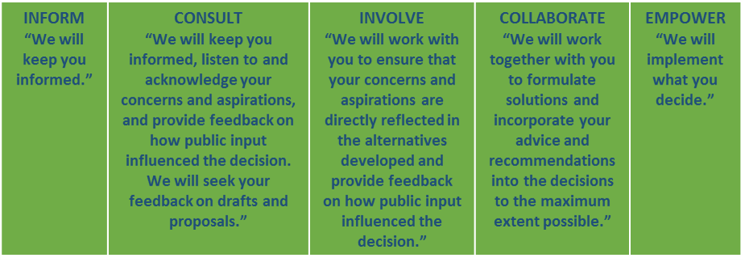
Where we are now?

Slide 5
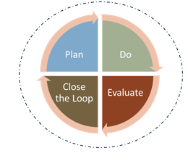

Today’s Focus – 360° of Public Engagement
A full story has a beginning, middle and end
To tell the complete story of who we are and what we do, we have to tell all facets
Opportunity to be holistic, looking at all 360° of the experience of how we interact with the public

Slide 6
Agenda
Project Development Continuum and Planning Exercise
PECS Strategic Priorities for 2018
Documenting PE Work
Evaluation and Research
Closing the Loop Exercise
When a Wrench Gets Thrown In Your Toolbox

Slide 7
Let’s get started

