Slide 1


2019 Public Engagement Workshop
Voice of the Customer
Public Engagement Workshop
March 7, 2019
March 7, 2019
St. Paul, MN

Slide 2
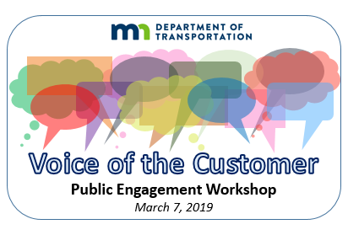
Welcome and Introduction
Richard D. Davis
Director − Public Engagement & Constituent Services

Slide 3
Since Last Year
Completed WIG 2.0
  MnDOT is a customer-centered organization
  Return what’s working to the whirlwind
  District stakeholder lists
Integrated engagement into Unified D&I Plan and Strategic Operating Plan
District-first staffing model and operating model adopted in recognition that “Engagement is local”
Move toward standard metrics, training and nomenclature
  IAP2 Spectrum
  Net Promoter Score

Slide 4
The Year Ahead
New administration with focus on engagement
Transportation funding debate = increased visibility for MnDOT
Strike the right balance between district autonomy and agency-wide standards
As focus on engagement increases, so does need to educate and train broader range of MnDOT staff

Slide 5
Today’s Objectives
Convene public engagement practitioners, policy makers and agency leaders to network, learn and celebrate public engagement accomplishments around the agency
Hear directly from customers about their experiences engaging with MnDOT
Highlight District success stories that demonstrate collecting and using the “Voice of the Customer”
Recognize award-winning public engagement work happening across the state
Discuss concepts and components of District/Office Engagement Plans

Slide 6
Agenda
Time | Topic
8:00 | Registration & Continental Breakfast
8:30 | Welcome & Introductions
9:15 | Voice of the Customer – Part I: Project-Related Engagement Panel
10:15 | Break
10:30 | Engagement in Indian Country
10:45 | Voice of the Customer - Part II: Ongoing Engagement Panel
11:45 | Lunch
12:30 | Keynote Speaker
1:00 | MnDOT Public Engagement Awards
2:00 | Break
2:30 | Voice of the Customer - Part III: District Engagement Plans Working Session
3:45 | Closing & Evaluation

Slide 7
Opening Remarks
Margaret Anderson Kelliher
MnDOT Commissioner

Slide 8
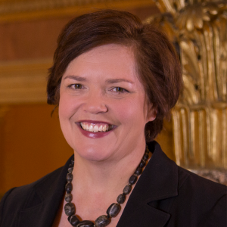
Commissioner Margaret Anderson Kelliher
Appointed MnDOT Commissioner Dec. 12, 2018
12 years in MN House of Representatives
Elected Speaker of the House for four years
Oversaw Transportation and Transit Funding package in 2008
B.A. in Political Science from Gustavus Adolphus College
M.P.A. from Harvard University Kennedy School of Government

Slide 9

District Spotlights
D1 – Duane Hill
District Engineer
D8 – Mandi Lighthizer-Schmidt
Public Engagement Director

Slide 10
Voice of the Customer – Part I
Project Related Engagement
Moderated by
Jim Skoog, Associate Ombudsman

Slide 11
Voice of the Customer – Part I
Project Related Engagement
Marvin Anderson
ReConnectRondo - St. Paul
Dean Chamberlain
Red Wing Staff Engineer
Debra and Adam Sisneros
Maple Grove Residents
Jim Swanson
VFW Quartermaster - Mapleton

Slide 12
BREAK

Slide 13
Engagement in Indian Country
Levi Brown
Tribal Liaison Manager

Slide 14
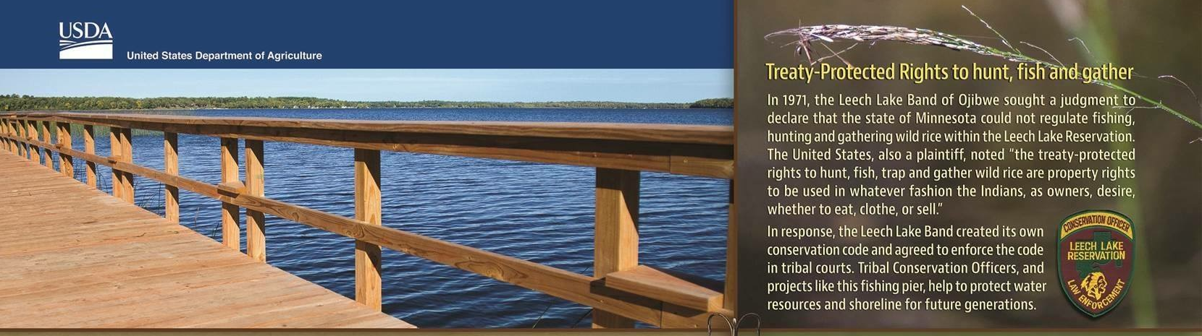
Public Engagement and Tribal Affairs
“Where St. Paul meets the Rez”
Levi Brown | Tribal Liaison Manager
Government Affairs
3-8-19

Slide 15

Tribal Governments in Minnesota
MnDOT District | Reservations/Tribal Lands
1 | Bois Forte, Leech Lake, Fond du Lac, Grand Portage, Mille Lacs
2 | Leech Lake, Red Lake, White Earth
3 | Leech Lake, Mille Lacs
4 | White Earth
6 | Prairie Island, Ho-Chunk
7 | None (Dakota 38 Memorial Ride)
8 | Lower Sioux, Upper Sioux
Metro | Shakopee Mdewakanton
Notes:
Levi
7 Ojibwe Tribes: Red Lake, Bois Forte, Grand Portage, White Earth, Leech Lake, Fond du Lac and Mille lacs
4 Dakota Tribes: Upper Sioux, Shakopee Mdewakanton, Prairie Island, and Lower Sioux

Slide 16
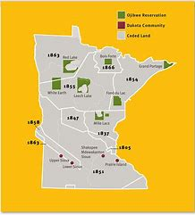

Tribal Government to State Government relations (G2G) and
Public Engagement
Tribal Nations have governing authority
Independent leadership
Elected in a democratic process
Relationship defined in the U.S. Constitution
Public Engagement and meaningful consultation
Consultation is implemented at the decision maker level
Proper G2G allows all parties involved to fine common ground and move forward in legal manner

Slide 17
MnDOT policies and programs directly affect
Indian tribes and their members
Trust Lands: Rights-of-Way
Indian Employment on/near reservations (Workforce and businesses)
Historic & Cultural Preservation
Road Safety
Reservation Road Signs
Transportation Planning
Partnering on Highway projects
D2 Success and Struggles
Tribes also affect MnDOT

Slide 18
Must continue educating on Tribal Issues
Federal laws
Treaties
Tribal Governance
Culture
Indian Lands

Slide 19
Thank you!
Levi Brown, Tribal Liaison Manager
MnDOT Office of Government Affairs
(651) 236-7048
levi.brown@state.mn.us

Slide 20
Voice of the Customer – Part II
Ongoing Engagement
Moderated by
Laurie Ryan, PECS Partner Relations

Slide 21
Voice of the Customer – Part II
Ongoing Engagement
Kristine Elwood
State Aid
Keith Mensah
Equity in Transportation
Jessica Oh
Highway Sponsorship Program
John Tompkins
Urban Freight Perspectives

Slide 22
District Spotlights
Metro – Dale Gade
North Area Engineer
D7 – Anne Wolff
Public Engagement Coordinator

Slide 23
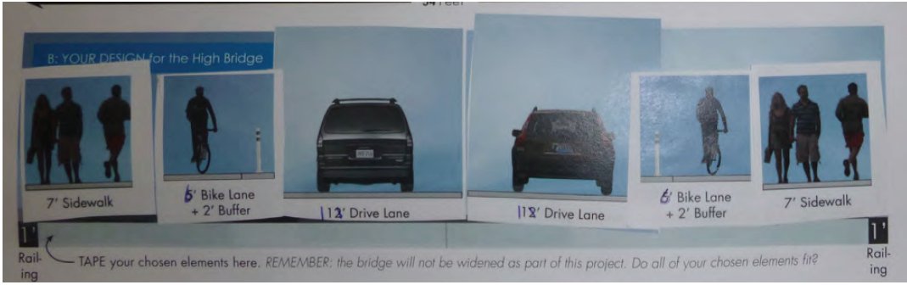
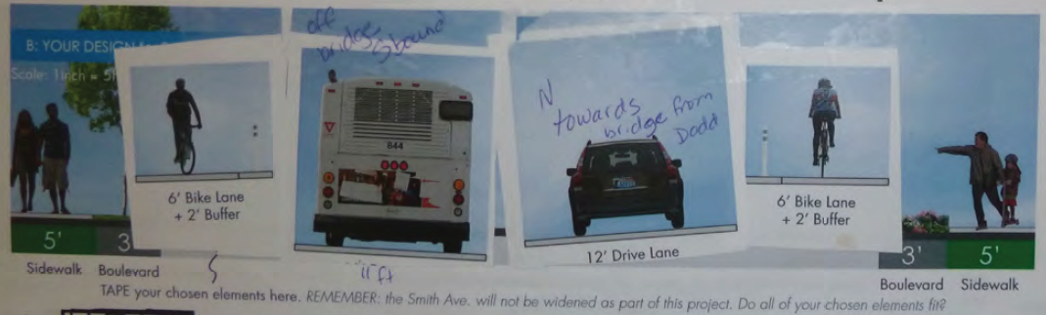
Smith Avenue - High Bridge

Slide 24
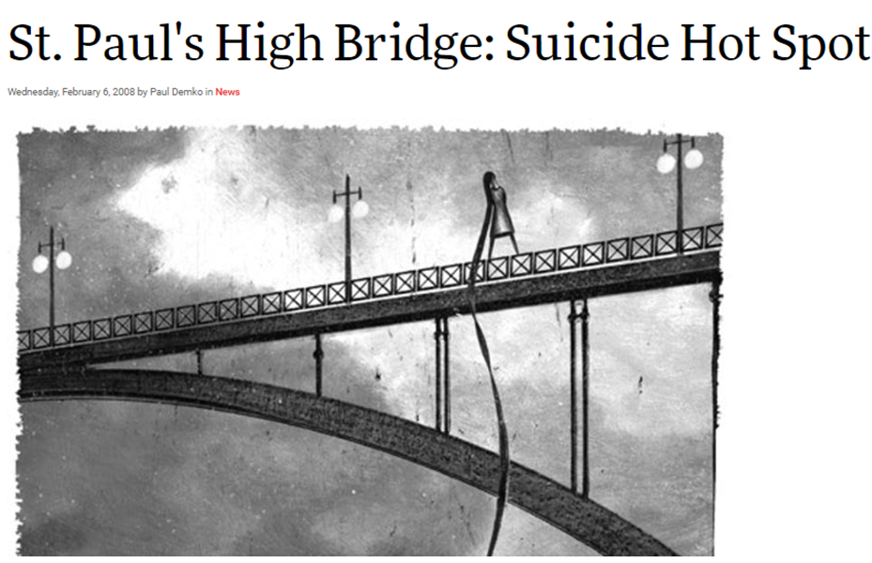
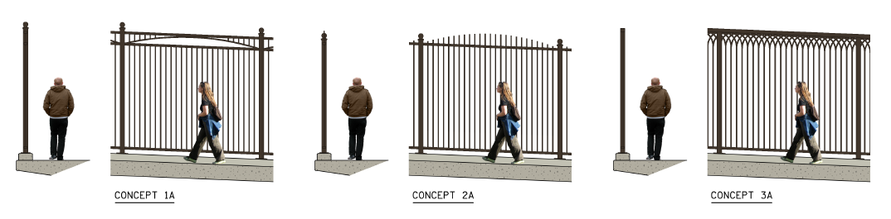
Smith Avenue - High Bridge

Slide 25
Smith Avenue - High Bridge
OTHER TOPICS
TREE REMOVALS
ENGAGEMENT ON A BUDGET
4f PROPERTY IMPACTS

Slide 26
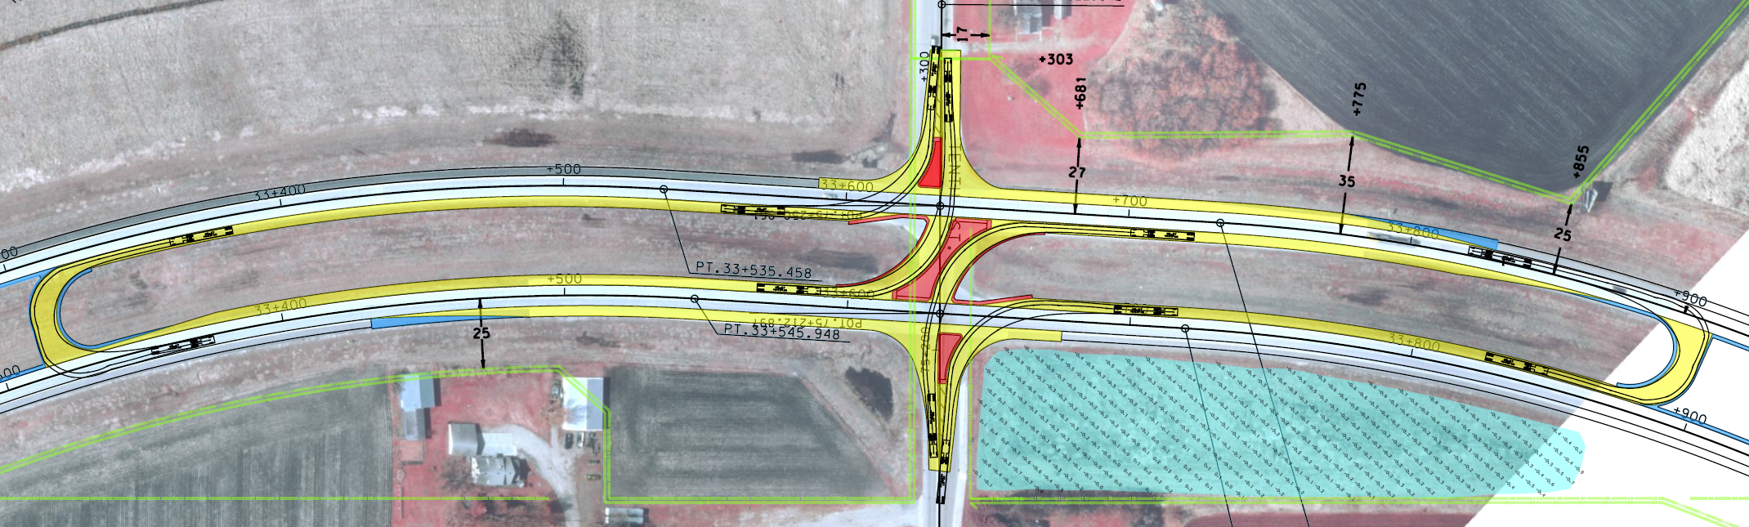
Heron Lake - RCUT Education
Anne Wolff| Public Engagement Coordinator
District 7
March 7, 2019

Slide 27
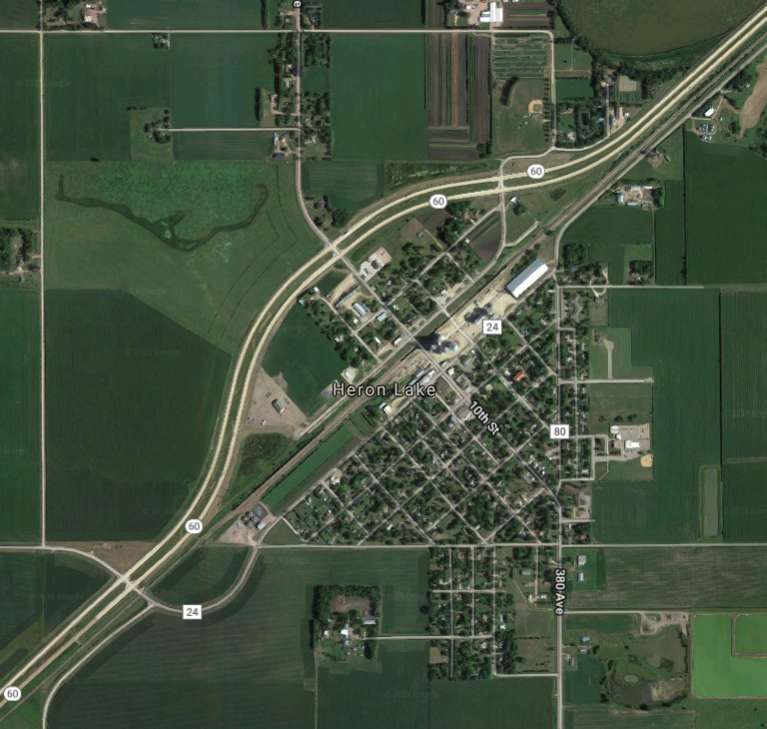
Heron Lake
75 miles south west of Mankato
City along Hwy 60
Large agricultural community

Slide 28
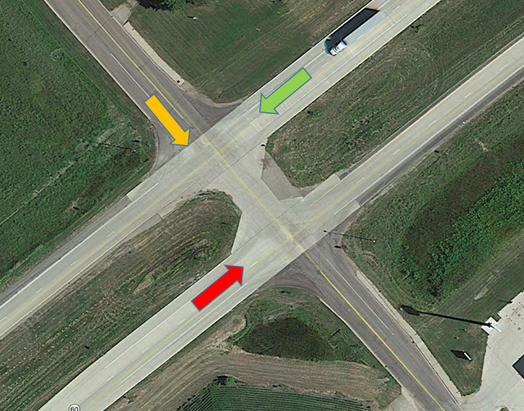
Reoccurring Problem: T-Bone Crashes
10th Street (Jackson CSAH 9)
  67% of crashes are right-angle crashes
  Almost exclusively far side crashes
  2007-2017 Right Angle Crash Severity:
    2 Fatal Crashes (three deceased)
    5 Non-Incapacitating Injury
    2 Possible Injury
    2 Property Damage

Slide 29
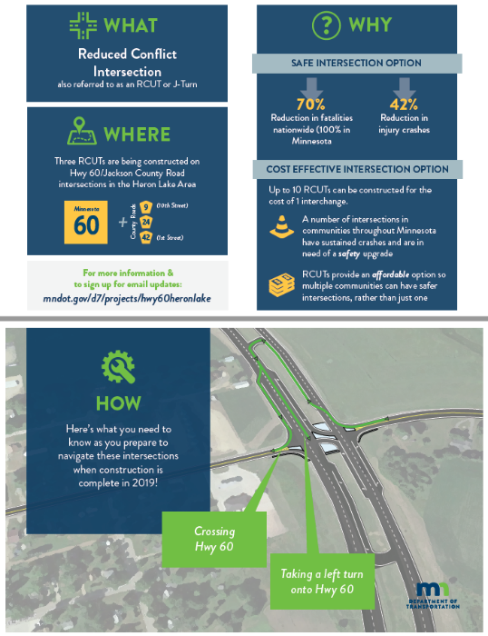
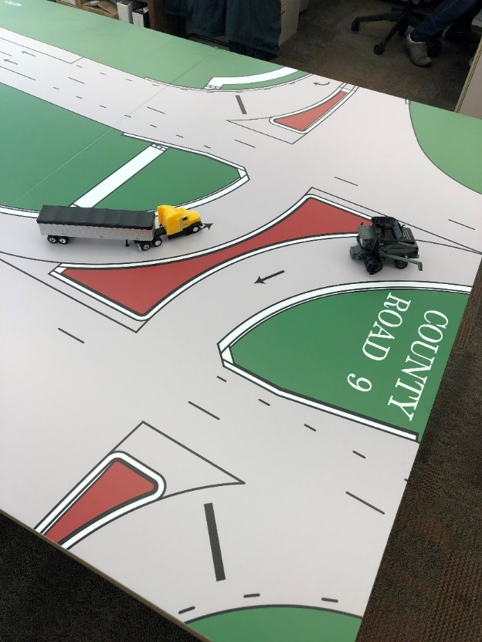
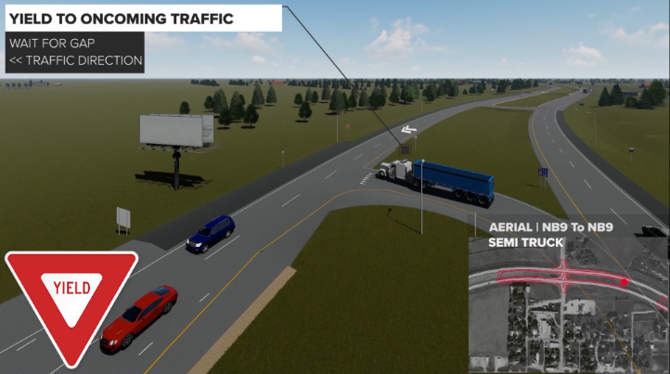
RCUT Education
Tools
  Animation video
  Matchbox layout
  Handouts
  Drone footage

Slide 30
Outreach – Go and Tell
Shift outreach from “come and see” to “go and tell”
  Farm & Home Show
  Parent Teacher Conferences/Health Fair
  Service club and community meetings – Lions Club, Senior Citizens Dinner Group
  Library event attendance
  Construction event

Slide 31
LUNCH

Slide 32
Keynote Speaker – Jeff Aguy
“We All Should Be Human-Centered Designers”

Slide 33
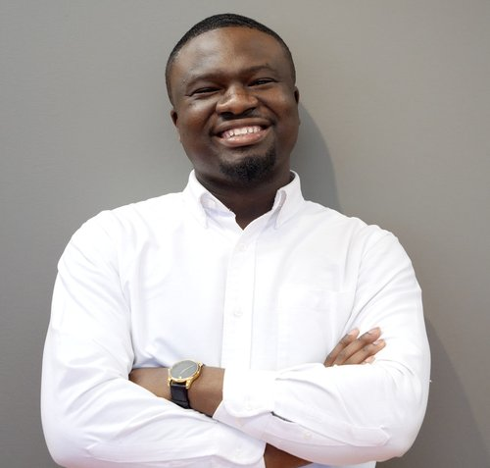
Keynote Speaker – Jeff Aguy
“We All Should Be Human-Centered Designers”
Grew up in a small village in Haiti without running water or flushable toilets and only occasional electricity.
A serial entrepreneur, Jeff has founded or co-founded five businesses in diverse sectors the past 7 years.
Currently, he works as the Program Director for Lunar Startups in St. Paul, MN
Bachelor of Science degree in Industrial-Organizational Psychology with a specialization in Statistical Analysis, Master of Arts in Leadership and also holds a Six-Sigma Black Belt Certification.
Possesses a deep sense of purpose, love for community, and a passion for solving complex problems and designing a better future

Slide 34
Public Engagement Awards

Slide 35
Award for Creativity and Innovation
Innovation is key for advancing public engagement and moving the agency forward.
This award is given to the project that best demonstrates innovative, creative use of planning, techniques and tools to effectively and meaningfully engage participants in a project or process.

Slide 36
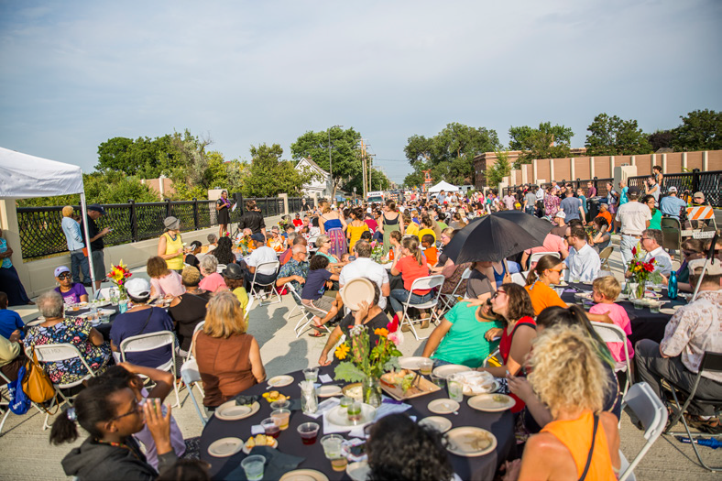
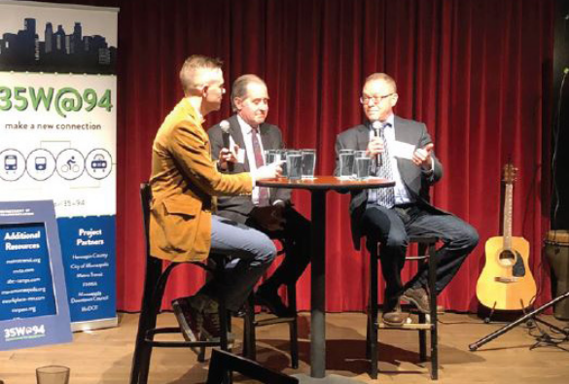
Award for Creativity and Innovation
Metro District – 35@94: Downtown to Crosstown
Challenge: Long-term closures of key access points; dense, urban setting
Approach: Implement a stand-alone engagement plan separate from construction communications to be carried out during construction

Slide 37
Award for Respect for
Diversity, Inclusion and Culture
This award is given to the plan, project or process that best demonstrates effective engagement of marginalized, underserved, vulnerable and “hard to reach” populations or a multicultural, linguistically diverse and/or bilingual process that reflect a depth and diversity of participants.

Slide 38
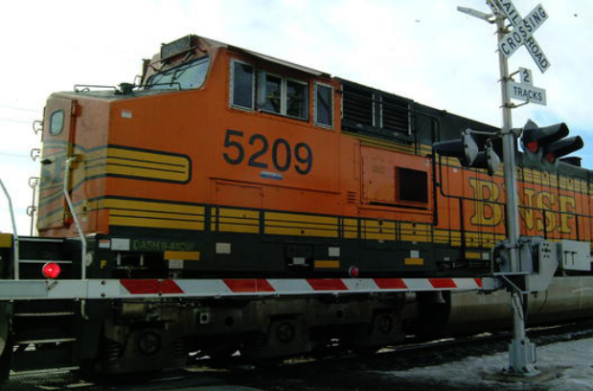
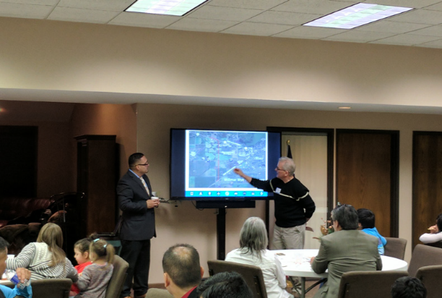
Award for Respect for
Diversity, Inclusion and Culture
District 8 - Willmar Wye Project
Challenge: Engage and involve a community where English is not the first language
Approach: Work through trusted community leaders and the faith community

Slide 39
Award for Best Engagement for
Small/Medium Project
Quality engagement is critical to successful outcomes.
This award will be given to the project that best reflects excellence in planning, tools, techniques and efforts in public engagement.

Slide 40
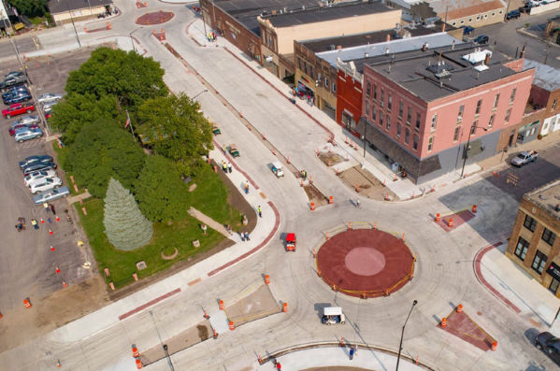
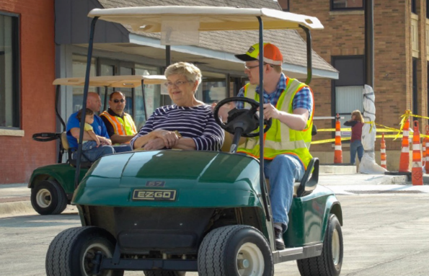
Award for Best Engagement for
Small/Medium Project
District 7 - Mini-Roundabouts, Highway 4 St. James
Challenge: Convince residents that mini-roundabouts would be the most viable way to keep Hwy 4 running through St. James
Approach: Build public support through education

Slide 41
Award for Best Engagement for a
Major Project
This award goes to the major project* that best
reflects excellence in planning, tools, techniques and efforts in public engagement.
*$30 million or more in the metropolitan highway construction district, $10 million in nonmetropolitan highway construction districts

Slide 42
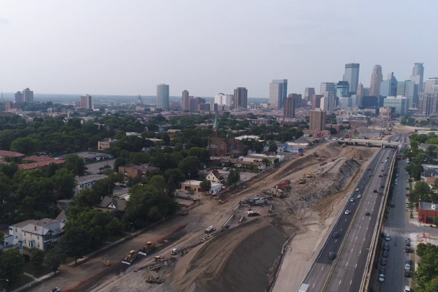
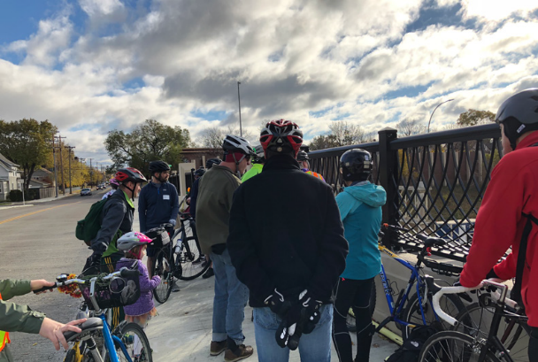
Award for Best Engagement for a
Major Project
Metro District: 35@94: Downtown to Crosstown
Challenge: Create meaningful engagement with the community throughout the length of the project
Approach: One-on-one meetings with officials, neighborhood associations and community leaders to learn how they would like to be engaged

Slide 43
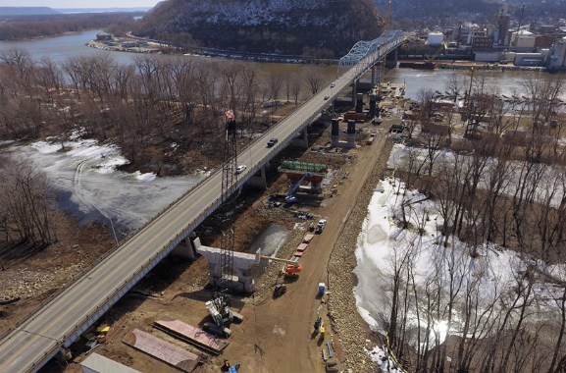
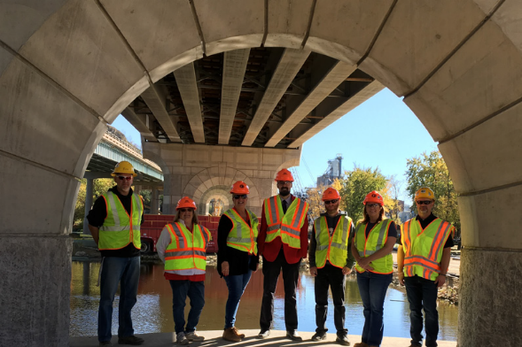
Award for Best Engagement for a
Major Project
District 6: Redwing Bridge
Challenge: Keep the community connected, aware and engaged throughout the length of the project
Approach: Used multiple channels to connect with the public on their terms

Slide 44
Award for Ongoing Engagement
This award recognizes the best overall ongoing (not project specific) public engagement effort demonstrated by an office or district.

Slide 45
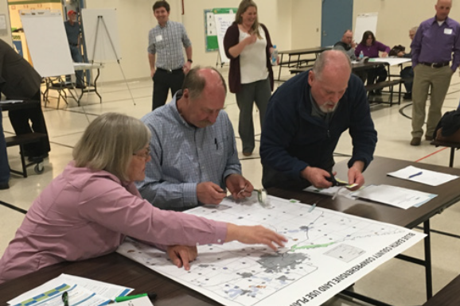
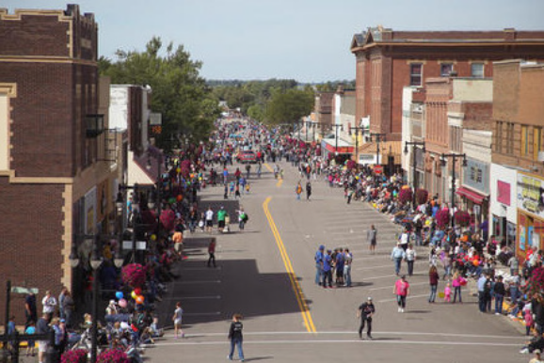
Award for Ongoing Engagement
District 7 - Pre-scoping Outreach
Challenge: Address growing number of scope changes due to issues uncovered late in project development
Approach: Incorporate early community outreach to build relationships, gain insights and reduce scope changes

Slide 46
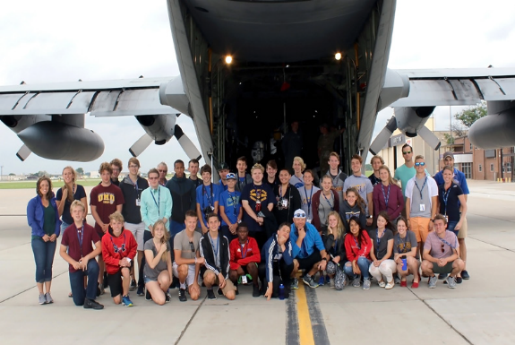
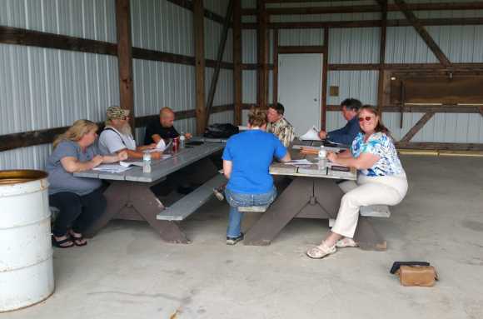
Award for Ongoing Engagement
Office of Aeronautics – Airports are Part of MnDOT Too
Challenge: Increase awareness of what local airports do for local and state economies
Approach: Meet with communities at local airport fly-ins and airshows to help the public understand their airport is a local gateway to the world

Slide 47
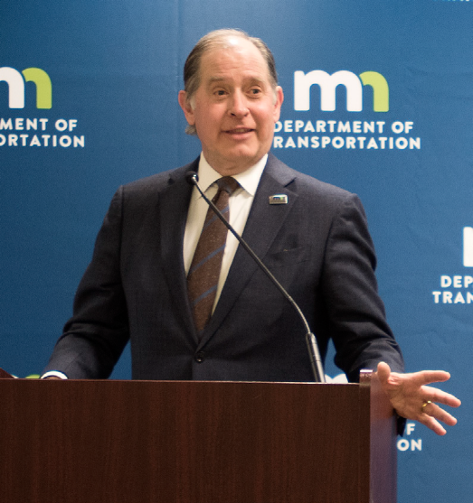
Commissioner’s Award for Public Engagement
Charlie Zelle, MnDOT Commissioner 2013 – 2018
Charlie Zelle made relationship building and engagement with the people of Minnesota an organizational priority.
His managerial style directly reflected his personal brand of servant leadership and openness by speaking with communities about the impact transportation projects have on people across the state.
His commitment to engagement was embedded through efforts such as WIG 2.0, our Public Engagement Policy, the Unified Diversity and Inclusion Plan and the 2018-2022 Strategic Operating Plan
“It is important that we become known as an organization that listens and acts on or responds to what it hears. It’s what the public deserves and should expect. “
Charlie Zelle, former MnDOT Commissioner

Slide 48
District Spotlights
D6 – Anne Meyer
Public Affairs Coordinator
D2 - T.J. Melcher
Public Engagement Director

Slide 49
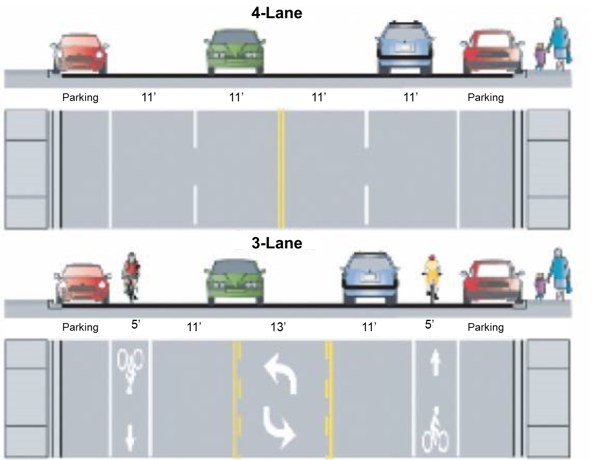
2019 Public Engagement Workshop
District Spotlight | District 2

Slide 50
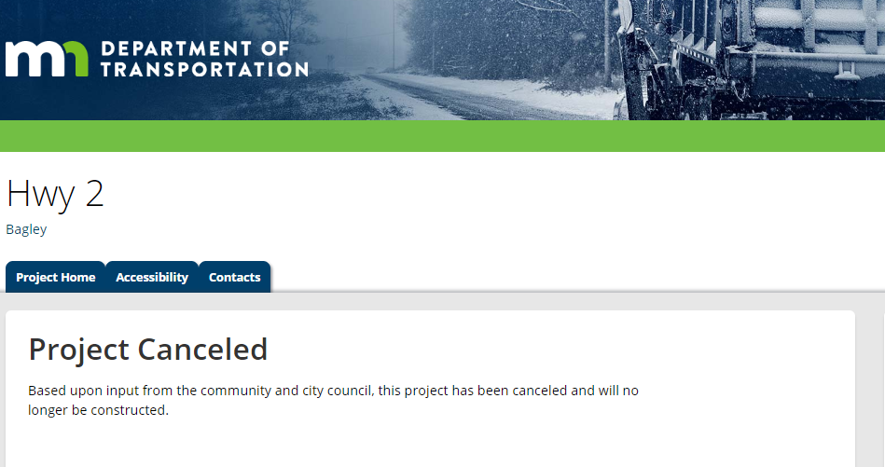
Voice of the customer
Hwy 2- Bagley
Location: Between Hwy 92 and Clearwater CR 25
SP: 1502-30
Project: Sealcoat (5 miles)
Dates: mid-Aug to mid-Sept 2018 (Letting 3/23/2018)
Cost Estimate: $150,000
Traffic Impacts: Lane closures
Benefits: Smoother, longer lasting road surface

Slide 51
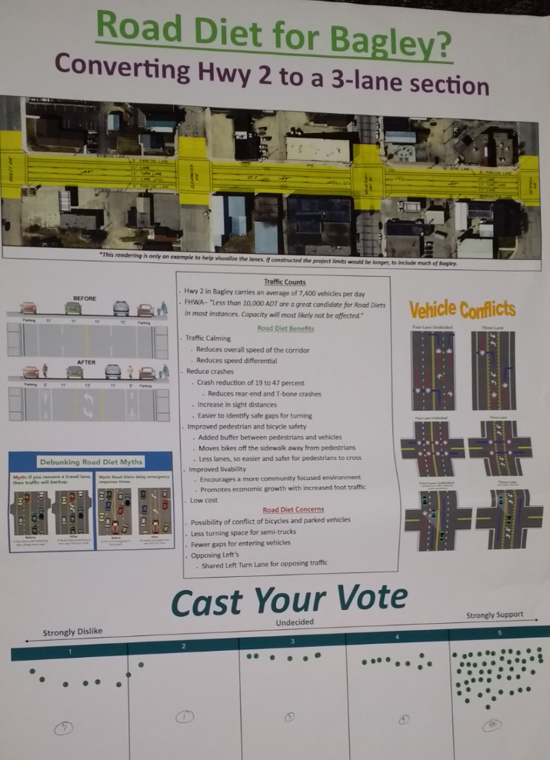




A straight path?
Detour
Support shown at County Fair
Initial support from City Council

Slide 52

Derailed
Feb 21- Meet with Chamber of Commerce
Mar 6- Business walk through
MnDOT pulls the project
Feb 20- Public hearing
Mar 8- PECS Survey
Aug 3-6 Clearwater County Fair
Mar 8- 2nd Public meeting
Mar 28- City Council votes to not support
Mar 13- Social media blitz
Mar 26- 3rd public meeting
Initial support from City Council

Slide 53
BREAK

Slide 54
District Spotlights
District 4 – Bryan Christensen
Public Engagement Coordinator
District 3 - Jon Mason
Senior Planner

Slide 55
Voice of the Customer – Part III
District Engagement Plans
Moderated by
Renee Raduenz, PECS Deputy Director

Slide 56
Closing Remarks and Next Steps
Richard D. Davis
Director − Public Engagement & Constituent Services

Slide 57
Next Steps
Workshop evaluations
Research meetings with DMTs and office directors
FY20-21 Business Planning
District engagement plans
Public Engagement Policy revisions
Evaluating and Right-Sizing PE
Training opportunities

Slide 58
THANK YOU!

